Slide 1

CS15-346
Perspectives in Computer Architecture
Single and Multiple Cycle Architectures
Lecture 5
January 28th, 2013

Slide 2
Objectives
Origins of computing concepts, from Pascal to Turing and von Neumann.
Principles and concepts of computer architectures in 20th and 21st centuries.
Basic architectural techniques including instruction level parallelism, pipelining, cache memories and multicore architectures
Architecture including various kinds of computers from largest and fastest to tiny and digestible.
New architectural requirements far beyond raw performance such as energy, programmability, security, and availability.
Architectures for mobile computing including considerations affecting hardware, systems, and end-to-end applications.

Slide 3
Where is “Computer Architecture”?
Application
Operating
Compiler
System
(Windows)
Software
Assembler
Instruction Set
Architecture
Hardware
Processor
Memory
I/O system
Datapath & Control
Digital Design
Architecture
Circuit Design
transistors
“Computer Architecture is the science and art of selecting and interconnecting hardware components to create computers that meet functional, performance and cost goals.”

Slide 4
Design Constraints & Applications
Functional
Reliable
High Performance
Low Cost
Low Power
Commercial
Scientific
Desktop
Mobile
Embedded
Smart sensors

Slide 5
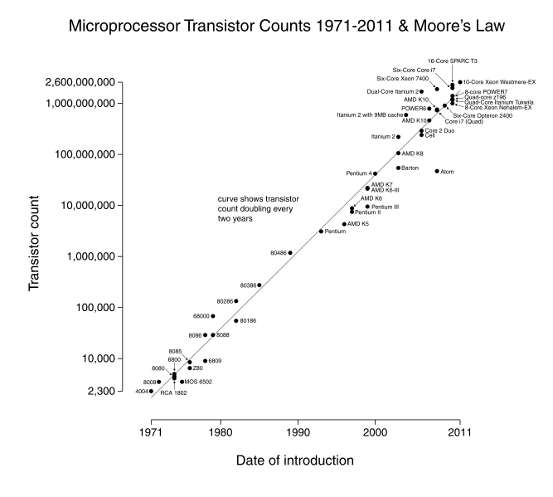
Moore’s Law
2 * transistors/Chip Every 1.5 to 2.0 years

Slide 6
Moore’s Law - Cont’d
Gordon Moore – cofounder of Intel
Increased density of components on chip
Number of transistors on a chip will double every year
Since 1970’s development has slowed a little
  Number of transistors doubles every 18 months
Cost of a chip has remained almost unchanged
Higher packing density means shorter electrical paths, giving higher performance
Smaller size gives increased flexibility
Reduced power and cooling requirements
Fewer interconnections increases reliability

Slide 7
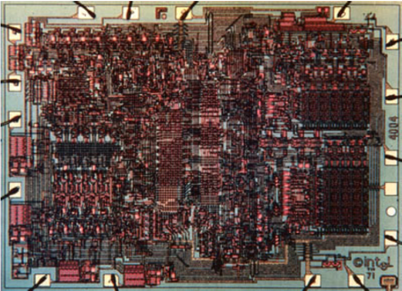
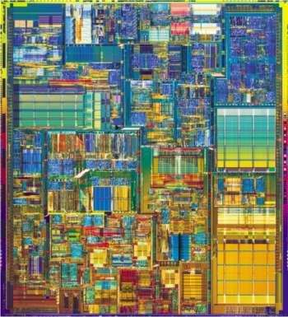
Single Cycle to Superscalar
Intel 4004 (1971)
Application: calculators
Technology: 10000 nm
2300 transistors
13 mm2
108 KHz
12 Volts
4-bit data
Single-cycle datapath
Intel Pentium4 (2003)
Application: desktop/server
Technology: 90nm (1/100x)
55M transistors (20,000x)
101 mm2 (10x)
3.4 GHz (10,000x)
1.2 Volts (1/10x)
32/64-bit data (16x)
22-stage pipelined datapath
3 instructions per cycle (superscalar)
Two levels of on-chip cache
Data-parallel vector (SIMD) instructions, hyperthreading

Slide 8
Moore’s Law—Walls
A number of “walls”
  Physical process wall
    Impossible to continue shrinking transistor sizes
    Already leading to low yield, soft-errors, process variations
  Power wall
    Power consumption and density have also been increasing
  Other issues:
    What to do with the transistors?
    Wire delays

Slide 9
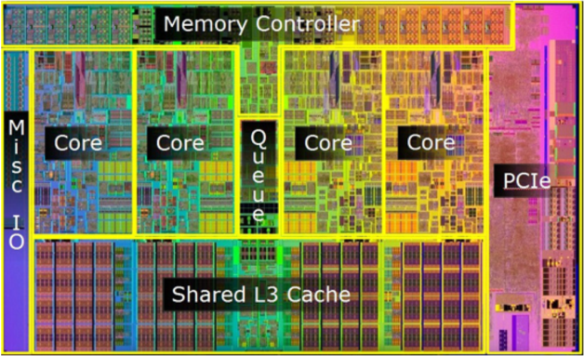
Single to Multi Core
Intel Pentium4 (2003)
Application: desktop/server
Technology: 90nm (1/100x)
55M transistors (20,000x)
101 mm2 (10x)
3.4 GHz (10,000x)
1.2 Volts (1/10x)
32/64-bit data (16x)
22-stage pipelined datapath
3 instructions per cycle (superscalar)
Two levels of on-chip cache
Data-parallel vector (SIMD) instructions, hyperthreading
Intel Core i7 (2009)
Application: desktop/server
Technology: 45nm (1/2x)
774M transistors (12x)
296 mm2 (3x)
3.2 GHz to 3.6 Ghz (~1x)
0.7 to 1.4 Volts (~1x)
128-bit data (2x)
14-stage pipelined datapath (0.5x)
4 instructions per cycle (~1x)
Three levels of on-chip cache
data-parallel vector (SIMD) instructions, hyperthreading
Four-core multicore (4x)

Slide 10
How much progress?
Item | Alto, 1972 | Chuck’s home PC, 2012 | Factor
Cost | $ 15,000 ($105K today) | $850 | 125
CPU clock rate | 6 MHz | 2.8 GHz (x4) | 1900
Memory size | 128 KB | 6 GB | 48000
Memory access | 850 ns | 50 ns | 17
Display pixels | 606 x 808 x 1 | 1920 x 1200 x 32 | 150
Network | 3 Mb Ethernet | 1 Gb Ethernet | 300
Disk capacity | 2.5 MB | 700 GB | 280000

Slide 11
Anatomy: 5 Components of Computer
Computer
Computer
Keyboard,
Mouse
Processor
Memory
(where
programs
& data
reside when
running)
Devices
Disk
(where
programs
& data
live when
not running)
Control
(“brain”)
Input
Datapath
(“work”)
Output
Display,
Printer
Notes:
That is, any computer, no matter how primitive or advance, can be divided into five parts:
1. The input devices bring the data from the outside world into the computer.
2. These data are kept in the computer’s memory until ...
3. The datapath request and process them.
4. The operation of the datapath is controlled by the computer’s controller.
All the work done by the computer will NOT do us any good unless we can get the data back to the outside world.
5. Getting the data back to the outside world is the job of the output devices.
The most COMMON way to connect these 5 components together is to use a network of busses.

Slide 12
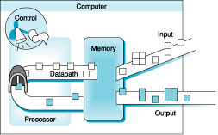
The Five Components of a Computer

Slide 13
Multiplication – longhand algorithm
Just like you learned in school
For each digit, work out partial product (easy for binary!)
Take care with place value (column)
Add partial products

Slide 14
Example of shift and add multiplication
 |  |  |  | 1 | 0 | 1 | 1
 |  |  | x | 1 | 1 | 0 | 1
 |  |  |  | 1 | 0 | 1 | 1
 |  |  | 0 | 0 | 0 | 0
 |  |  | 0 | 1 | 0 | 1 | 1
 |  | 1 | 0 | 1 | 1
 |  | 1 | 1 | 0 | 1 | 1 | 1
 | 1 | 0 | 1 | 1
1 | 0 | 0 | 0 | 1 | 1 | 1 | 1
How many steps?
How do we implement this in hardware?

Slide 15
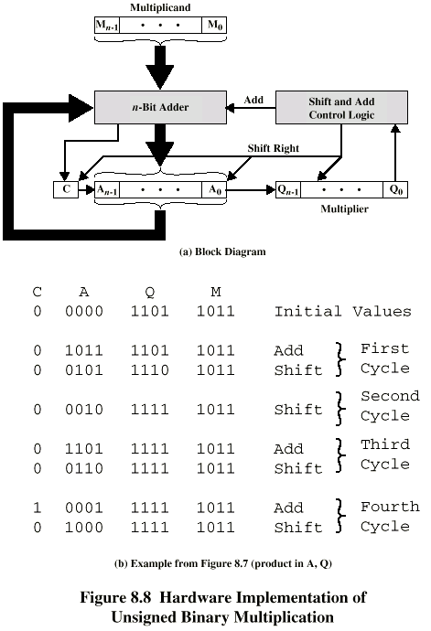
Unsigned Binary Multiplication

Slide 16
Execution of Example

Slide 17
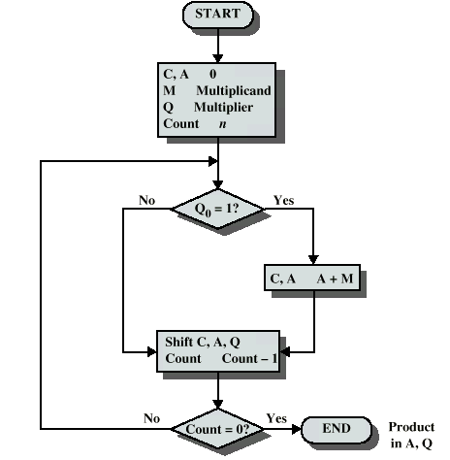
Flowchart for Unsigned Binary Multiplication

Slide 18
Multiplying Negative Numbers
This does not work!
Solution 1
  Convert to positive if required
  Multiply as above
  If signs were different, negate answer
Solution 2
  Booth’s algorithm

Slide 19
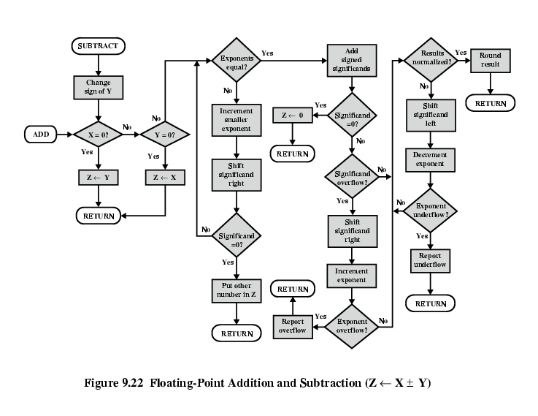
FP Addition & Subtraction Flowchart

Slide 20
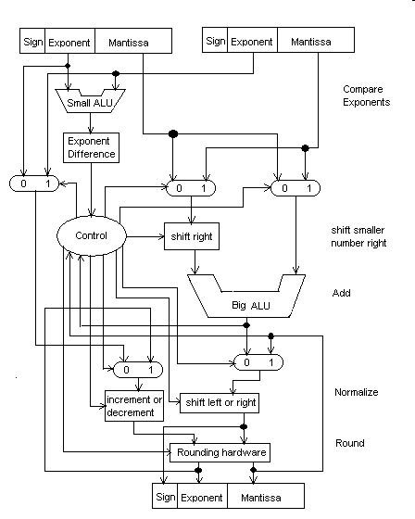
Floating point adder

Slide 21
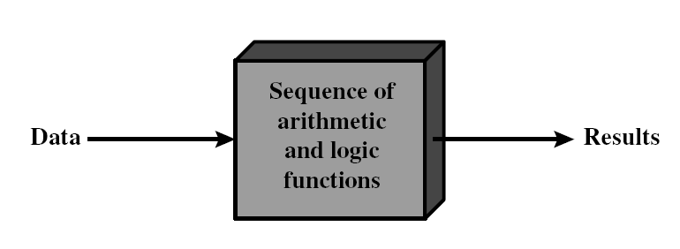
Execution of a Program

Slide 22
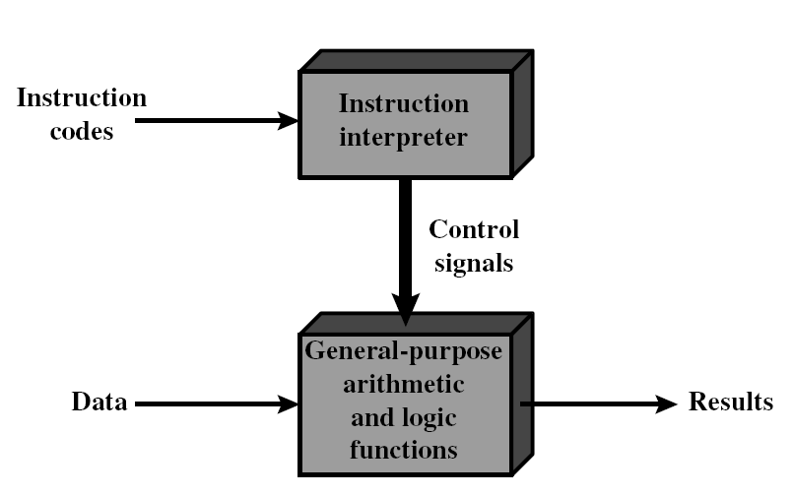
Program -> Sequence of Instructions

Slide 23
Function of Control Unit
For each operation a unique code is provided
  e.g. ADD, MOVE
A hardware segment accepts the code and issues the control signals
We have a computer!

Slide 24
Computer Components: Top Level View
CPU
Memory
Address
Bus
Instructions
Register
File
Control
Data
IR
Functional
Units
Data
Bus
PC

Slide 25
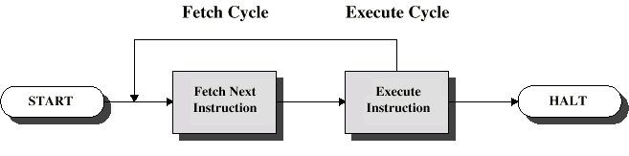
Instruction Cycle
Two steps:
  Fetch
  Execute

Slide 26
Fetch Cycle
Program Counter (PC) holds address of next instruction to fetch
Processor fetches instruction from memory location pointed to by PC
Increment PC (PC = PC + 1)
  Unless told otherwise
Instruction loaded into Instruction Register (IR)
Processor interprets instruction

Slide 27
Execute Cycle
Processor-memory
  Data transfer between CPU and main memory
Processor I/O
  Data transfer between CPU and I/O module
Data processing
  Some arithmetic or logical operation on data
Control
  Alteration of sequence of operations
  e.g. jump
Combination of above

Slide 28
Instruction Set Architecture
Application
Operating
Compiler
System
(Windows)
Software
Assembler
SW/HW
Interface
Instruction Set
Architecture
Hardware
Processor
Memory
I/O system
Datapath & Control
Digital Design
Circuit Design
transistors
ISA:
• A well-defined hardware/software interface
• The “contract” between software and hardware

Slide 29
What is an instruction set?
The complete collection of instructions that are understood by a CPU
Machine Code
Binary
Usually represented by assembly codes
Notes:
2

Slide 30
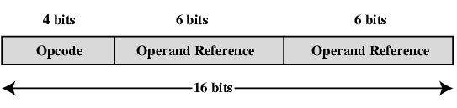
Elements of an Instruction
Operation code (Op code)
  Do this operation
Source Operand reference
  To this value
Result Operand reference
  Put the answer here
Notes:
3

Slide 31
Operation Code
Operation code
(Opcode)
  Do this operation
Name | Mnemonic
Addition | ADD
Subtraction | SUB
… | …
Multiply | MULT

Slide 32
Instruction Design: Add R0, R4, R11
Add | R1, | R2, | R3
001 | 01 | 10 | 11
OpCode | Destination Register | Source Register | Source Register
3-bits | 2-bits | 2-bits | 2-bits
9-bits Instruction

Slide 33
Add R1, R2, R3 ;(= 001011011)
What happens inside the CPU?
0
1
Register
File
I.R.
001011011
2
001011011
2
001011011
...
3
P.C.
2
3
4
Functional
Units
5
6
7
CPU
Memory

Slide 34
Add R1, R2, R3 ;(= 001011011)
R1
011111111
001010101
R3
Next
Instruction
I.R.
001011011
R2
010101010
...
P.C.
3
4
010101010
001010101
+
CPU

Slide 35
Execution of a simple program
The following program was loaded in memory starting from memory location 0.
0000 Load R2, ML4 ; R2 = (ML4) = 5 = 101₂
0001 Read R3, Input14 ; R3 = input device 14 = 7
0010 Sub R1, R3, R2 ; R1 = R3 – R2 = 7 – 5 = 2
0011 Store R1, ML5 ; store (R1) = 2 in ML5

Slide 36
The Program in Memory
Load | R2, | ML4
010 | 10 | 0100
Read | R3, | Input14
100 | 11 | 0100
Sub | R1, | R3, | R2
000 | 01 | 11 | 10
Store | R1, | ML5
011 | 01 | 0101
0 | 0000 | 010100110
1 | 0001 | 100110100
2 | 0010 | 000011110
3 | 0011 | 011010111
4 | 0100 | 000000101
… | … | Don’t care
14 | 1011 | Input Port
15 | 1111 | Output Port
Address |  | Content

Slide 37
Load R2, ML4 ; 010100110
R1
R3
I.R.
010100110
R2
000000101
...
P.C.
0
1
Load
CPU

Slide 38
Read R3, Input14 ; 100110100
010100110
R1
R3
100110100
000000111
R2
000000101
...
1
2
Read
CPU

Slide 39
Sub R1, R3, R2 ; 000011110
100110101
R1
R3
000011110
000000010
000000111
R2
000000101
...
2
3
000000101
000000111
Sub
CPU

Slide 40
Store R1, ML5 ; 011010111
Next
Instruction
R1
R3
011010111
Don’t Care
000000010
000000111
R2
000000101
...
3
4
Store
CPU

Slide 41
In Memory
0 | 0000 | 010100110
1 | 0001 | 100110100
2 | 0010 | 000011110
3 | 0011 | 011010111
4 | 0100 | 000000101
5 | 0101 | Don’t care
… | … | Don’t care
14 | 1011 | Input Port
15 | 1111 | Output Port
Address |  | Content
Before
Program
Execution
After
Program
Execution
000000010

Slide 42
Computer Performance
Response Time (latency)
— How long does it take for my job to run?
— How long does it take to execute a job?
— How long must I wait for the database query?
Throughput
— How many jobs can the machine run at once?
— What is the average execution rate?
— How much work is getting done?
Notes:
Have them raise their hands when
answering questions

Slide 43
Execution Time
Elapsed Time (wall time)
  counts everything
  (disk and memory accesses, I/O , etc.)
  a useful number, but often not good for comparison purposes

Slide 44
Execution Time
CPU time
  Does not count I/O or time spent running other programs
  Can be broken up into system time, and user time
  Our focus: user CPU time
  Time spent executing the lines of code that are "in" our program

Slide 45
Definition of Performance
For some program running on machine X,
Performance_{X} = 1 / Execution time_{X}
"X is n times faster than Y"
Performance_{X} / Performance_{Y} = n

Slide 46
Definition of Performance
Problem:
  machine A runs a program in 20 seconds
  machine B runs the same program in 25 seconds

Slide 47
Comparing and Summarizing Performance
 | Computer A | Computer B
Program1(sec) | 1 | 10
Program2(sec) | 1000 | 100
Total time (sec) | 1001 | 110
How to compare the performance?
Total Execution Time : A Consistent Summary Measure

Slide 48
Clock Cycles
Instead of reporting execution time in seconds, we often use cycles:
Clock “ticks” indicate when to start activities:
time

Slide 49
Clock cycles
cycle time = time between ticks = seconds per cycle
clock rate (frequency) = cycles per second
(1 Hz = 1 cycle/sec)
A 4 Ghz clock has a 250ps cycle time

Slide 50
CPU Execution Time
CPU
execution
time
for
a
program
=
(CPU
clock
cycles
for
a
program)
x
(clock
cycle
time)
Seconds
Cycles
Seconds
=
×
Program
Program
Cycle
cycles
cycle
=
/
Program
sec
onds
cycle
/
sec
onds
=
clock
rate

Slide 51
How to Improve Performance
So, to improve performance (everything else being equal) you can either increase or decrease?
________ the # of required cycles for a program, or
________ the clock cycle time or, said another way,
________ the clock rate.

Slide 52
How to Improve Performance
So, to improve performance (everything else being equal) you can either increase or decrease?
_decrease_ the # of required cycles for a program, or
_decrease_ the clock cycle time or, said another way,
_increase_ the clock rate.

Slide 53
How many cycles are required for a program?
Could we assume that # of cycles equals # of instructions
1st instruction
2nd instruction
3rd instruction
4th
5th
6th
...
time
This assumption is incorrect, different instructions take different amounts of time on different machines.

Slide 54
Different numbers of cycles for different instructions
time
Multiplication takes more time than addition
Floating point operations take longer than integer ones
Accessing memory takes more time than accessing registers
Important point: changing the cycle time often changes the number of cycles required for various instructions

Slide 55
Now that we understand cycles
Components of Performance | Units of Measure
CPU execution time for a program | Seconds for the program
Instruction count | Instructions executed for the program
Clock Cycles per Instruction (CPI) | Average number of clock cycles per instruction
Clock cycle time | Seconds per clock cycle
CPU time = Instruction count x CPI x clock cycle time

Slide 56
Implementation vs. Performance
CPU time = Instruction count x CPI x clock cycle time
Performance of a processor is determined by
  Instruction count of a program
    The compiler & the ISA determine the instruction count.
  CPI
    The ISA & implementation of the processor determines the CPI.
  Clock cycle time (clock rate)
    The implementation of the processor determines the clock cycle time.

Slide 57
CPI, Clocks Per Instruction
CPU clock cycles = Instructions for a program
x Average clock cycles per Instruction (CPI)
CPU time = Instruction count x CPI x clock cycle time

Slide 58
Performance
Performance is determined by execution time
Do any of the other variables equal performance?
  # of cycles to execute program?
  # of instructions in program?
  # of cycles per second?
  average # of cycles per instruction?
  average # of instructions per second?
Common pitfall: thinking one of the variables is indicative of performance when it really isn’t.

Slide 59
CPU Clock Cycles
CPI_{i} : the average number of cycles per instructions for that instruction class
C_{i} : the count of the number of instructions of class i executed.
n : the number of instruction classes.

Slide 60
Example
Instruction Classes:
  Add
  Multiply
Average Clock Cycles per Instruction:
  Add 1cc
  Mul 3cc
Program A executed:
  10 Add instructions
  5 Multiply instructions

Slide 61
CISC vs. RISC
CISC (Complex Instruction Set Computing) ISAs
  Complex instructions
  Low instructions in a program
  Higher CPI and cycle time
RISC (Reduced Instruction Set Computer)
  Simple instructions
  Low CPI and cycle time
  Higher instructions in a program

Slide 62
The Big Picture of a Computer System
Main
Memory
Input
/
Output
Processor
Datapath
Control

Slide 63
Focusing on CPU & Memory
CPU
Memory
Datapath
PC
Data
IR
Register File
Control
Unit
Address
ALU

Slide 64
The Datapath
: (Register File)
A load / store machine (RISC), register – register where access to memory is only done by load & store operations.
Destination
Register File
Source 1
Source 2
Control
ALU
Result

Slide 65
The Datapath
: (ALU)
A load / store machine (RISC), register – register where access to memory is only done by load & store operations.
Destination
Register File
Source 1
Source 2
Control
ALU
Result

Slide 66
Simple ALU Design
s1_bus
s2_bus
control
Add/Sub
Shift/Logic
16 to 8 MUX
dest_bus

Slide 67
How about the Control?
CPU
Memory
Datapath
PC
Data
IR
Register File
Control
Unit
Address
ALU

Slide 68
The Control Unit
Control Logic

Slide 69
FSM for addition in Load/Store Architecture
Fetch Instruction (Add R₁, R₂)
Registers R₁ and R₂
Fetch
Decode
Send signal to ALU to perform addition
Fetch next instruction
Store result
ALU Execute
Store result in R₁

Slide 70
The Control Unit When Add is Executing
Control Logic
The control
Turns on
the required
lines. In the
Case of add,
Ex: ALU OP,
ALU source,
Etc.
Instruction

Slide 71
Possible Execution Steps of Any Instruction
Instruction Fetch
Instruction Decode and Register Fetch
Execution of the Memory Reference Instruction
Execution of Arithmetic-Logical operations
Branch Instruction
Jump Instruction

Slide 72
Instruction Processing
Five steps:
  Instruction fetch (IF)
  Instruction decode and operand fetch (ID)
  ALU/execute (EX)
  Memory (not required) (MEM)
  Write-back (WB)
WB
IF
EX
ID
MEM

Slide 73
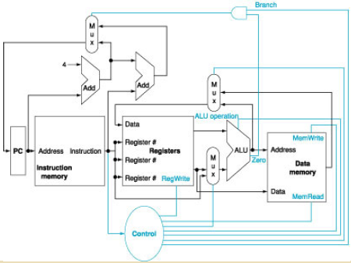
Datapath & Control
Control

Slide 74
Datapath Elements
The data path contains 2 types of logic elements:
  Combinational: (e.g. ALU)
  Elements that operate on data values. Their outputs depend on their inputs.
  State: (e.g. Registers & Memory)
  Elements with internal storage. Their state is defined by the values they contain.

Slide 75
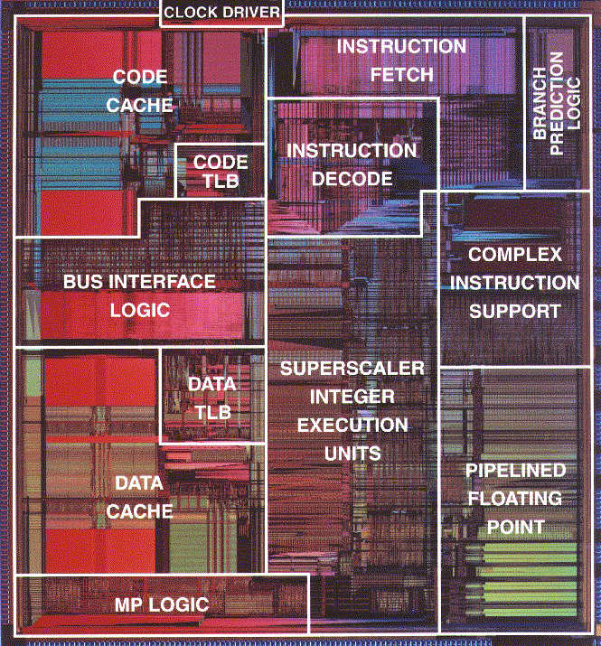
Pentium Processor Die
REG

Slide 76
Abstract View of the Datapath

Slide 77
Single Cycle Implementation
This simple processor can compute ALU instructions, access memory or compute the next instruction's address in a single cycle.
Single Cycle Implementation:
Cycle 1
Cycle 2
Clk
Load
ADD

Slide 78
Possible Execution Steps of Any Instructions
Instruction Fetch
Instruction Decode and Register Fetch
Execution of the Memory Reference Instruction
Execution of Arithmetic-Logical operations
Branch Instruction
Jump Instruction

Slide 79
Instruction Processing
Five steps:
  Instruction fetch (IF)
  Instruction decode and operand fetch (ID)
  ALU/execute (EX)
  Memory (not required) (MEM)
  Write-back (WB)
WB
IF
EX
ID
MEM

Slide 80
Single Cycle Implementation

Slide 81
Multiple ALUs and Memory Units

Slide 82
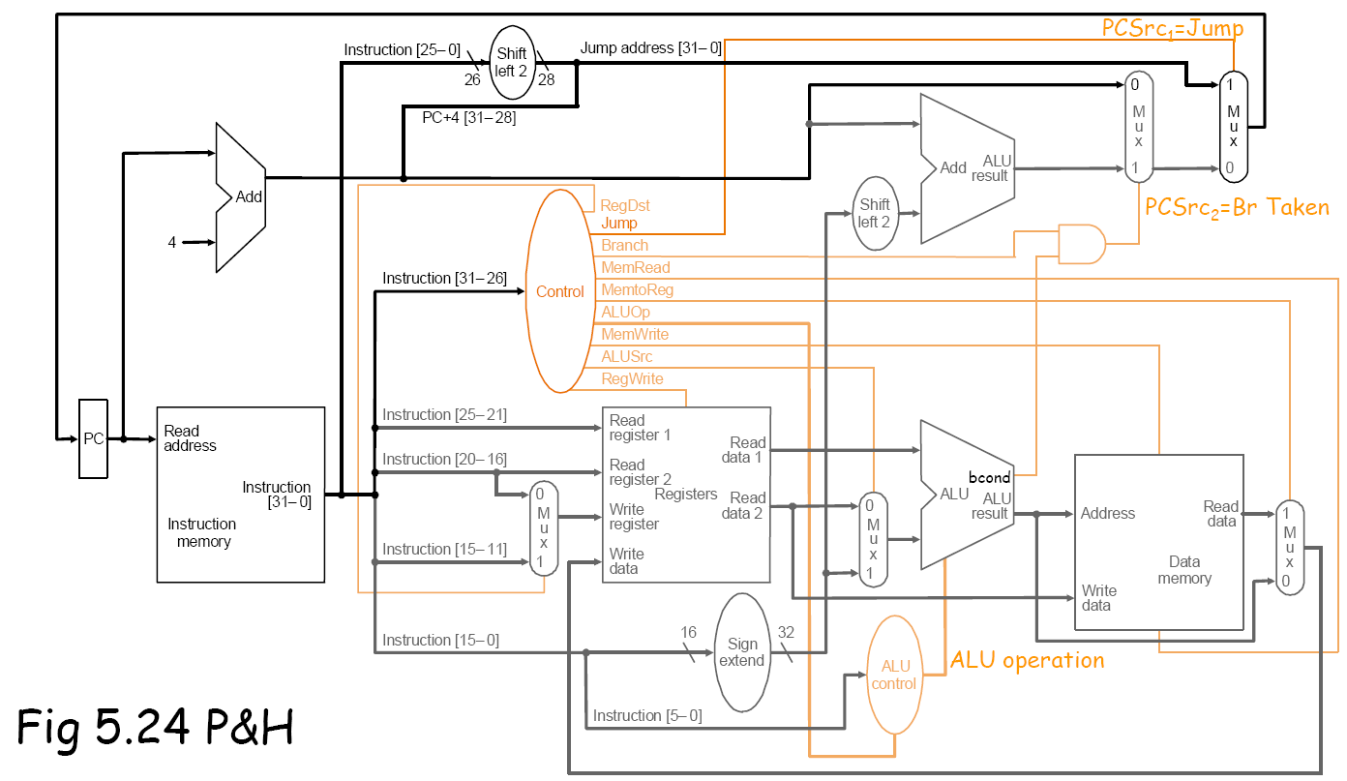
Single Cycle Datapath

Slide 83
What’s Wrong with Single Cycle?
All instructions run at the speed of the slowest instruction.
Adding a long instruction can hurt performance
  What if you wanted to include multiply?
You cannot reuse any parts of the processor
  We have 3 different adders to calculate PC+4, PC+4+offset and the ALU
No profit in making the common case fast
  Since every instruction runs at the slowest instruction speed
    This is particularly important for loads as we will see later

Slide 84
What’s Wrong with Single Cycle?
  1 ns – Register read/write time
  2 ns – ALU/adder
  2 ns – memory access
  0 ns – MUX, PC access, sign extend, ROM
  add: 2ns + 1ns + 2ns + 1ns = 6 ns
  beq: 2ns + 1ns + 2ns = 5 ns
  sw: 2ns + 1ns + 2ns + 2ns = 7 ns
  lw: 2ns + 1ns + 2ns + 2ns + 1ns = 8 ns
Get read ALU mem write
Instr reg operation reg

Slide 85
Computing Execution Time
Assume: 100 instructions executed
  25% of instructions are loads,
  10% of instructions are stores,
  45% of instructions are adds, and
  20% of instructions are branches.
Single-cycle execution:
100 * 8ns = 800 ns
Optimal execution:
25*8ns + 10*7ns + 45*6ns + 20*5ns = 640 ns

Slide 86
Single Cycle Problems
A sequence of instructions:
    LW (IF, ID, EX, MEM, WB)
    SW (IF, ID, EX, MEM)
    etc
Single Cycle Implementation:
Cycle 1
Cycle 2
Clk
Load
Store
Waste
  what if we had a more complicated instruction like floating point?
  wasteful of area

Slide 87
Multiple Cycle Solution
  use a “smaller” cycle time
  have different instructions take different numbers of cycles
  a “multicycle” datapath:

Slide 88
Multicycle Approach
We will be reusing functional units
  ALU used to compute address and to increment PC
  Memory used for instruction and data
We will use a finite state machine for control

Slide 89
The Five Stages of an Instruction
Cycle 1
Cycle 2
Cycle 3
Cycle 4
Cycle 5
IF
ID
Ex
Mem
WB
IF: Instruction Fetch and Update PC
ID: Instruction Decode and Registers Fetch
Ex: Execute R-type; calculate memory address
Mem: Read/write the data from/to the Data Memory
WB: Write the result data into the register file
Notes:
As shown here, each of these five steps will take one clock cycle to complete.

Slide 90
Multicycle Implementation
Break up the instructions into steps, each step takes a cycle
  balance the amount of work to be done
  restrict each cycle to use only one major functional unit
At the end of a cycle
  store values for use in later cycles (easiest thing to do)
  introduce additional “internal” registers

Slide 91
The Five Stages of Load Instruction
Cycle 1
Cycle 2
Cycle 3
Cycle 4
Cycle 5
lw
IF
ID
Ex
Mem
WB
IF: Instruction Fetch and Update PC
ID: Instruction Decode and Registers Fetch
Ex: Execute R-type; calculate memory address
Mem: Read/write the data from/to the Data Memory
WB: Write the result data into the register file
Notes:
As shown here, each of these five steps will take one clock cycle to complete.

Slide 92
Multiple Cycle Implementation
Break the instruction execution into Clock Cycles
  Different instructions require a different number of clock cycles
  Clock cycle is limited by the slowest stage
  Instruction latency is not reduced (time from the start of an instruction to its completion)
Cycle 1
Cycle 2
Cycle 3
Cycle 4
Cycle 5
Cycle 6
Cycle 7
Cycle 8
Cycle 9
lw
IFetch
Dec
Exec
Mem
WB
sw
IFetch
Dec
Exec
Mem
WB
Notes:
Latency = execution time (delay or response time) – the total time from start to finish of ONE instruction
For processors one important measure is THROUGHPUT (or the execution bandwidth) – the total amount of work done in a given amount of time
For memories one important measure is BANDWIDTH – the amount of information communicated across an interconnect (e.g., bus) per unit time; the number of operations performed per second (the WIDTH of the operation and the RATE of the operation)

Slide 93
Single Cycle vs. Multiple Cycle
Single Cycle Implementation:
Cycle 1
Cycle 2
Clk
Load
Store
Waste
Multiple Cycle Implementation:
Cycle 1
Cycle 2
Cycle 3
Cycle 4
Cycle 5
Cycle 6
Cycle 7
Cycle 8
Cycle 9
Cycle 10
Clk
lw
sw
R-type
IFetch
Dec
Exec
Mem
WB
IFetch
Dec
Exec
Mem
IFetch
Notes:
Here are the timing diagrams showing the differences between the single cycle, multiple cycle, and pipeline implementations.
For example, in the pipeline implementation, we can finish executing the Load, Store, and R-type instruction sequence in seven cycles.

Slide 94
Multicycle Implementation
Break up the instructions into steps, each step takes a cycle
  balance the amount of work to be done
  restrict each cycle to use only one major functional unit
At the end of a cycle
  store values for use in later cycles (easiest thing to do)
  introduce additional “internal” registers

Slide 95
Single Cycle vs. Multi Cycle
Single-cycle datapath:
Fetch, decode, execute one complete instruction every cycle
Takes 1 cycle to execution any instruction by definition (CPI=1)
Long cycle time to accommodate slowest instruction
(worst-case delay through circuit, must wait this long every time)
Multi-cycle datapath:
Fetch, decode, execute one complete instruction over multiple cycles
Allows instructions to take different number of cycles
Short cycle time
Higher CPI

Slide 96
Pipelining and ILP
How can we increase the IPC? (IPC=1/CPI)
  CPU time = Instruction count x CPI x clock cycle time
Cycle 1
Cycle 2
Cycle 3
Cycle 4
Cycle 5
Cycle 6
Cycle 7
Cycle 8
Cycle 9
Cycle 10
Clk
lw
sw
R-type
IFetch
Dec
Exec
Mem
WB
IFetch
Dec
Exec
Mem
IFetch

