Slide 1

CS15-346
Perspectives in Computer Architecture
Pipelining and Instruction Level Parallelism
Lecture 6
January 30th, 2013

Slide 2
Objectives
Origins of computing concepts, from Pascal to Turing and von Neumann.
Principles and concepts of computer architectures in 20th and 21st centuries.
Basic architectural techniques including instruction level parallelism, pipelining, cache memories and multicore architectures
Architecture including various kinds of computers from largest and fastest to tiny and digestible.
New architectural requirements far beyond raw performance such as energy, programmability, security, and availability.
Architectures for mobile computing including considerations affecting hardware, systems, and end-to-end applications.

Slide 3
Computer Performance
Response Time (latency)
— How long does it take for my job to run?
— How long does it take to execute a job?
— How long must I wait for the database query?
Throughput
— How many jobs can the machine run at once?
— What is the average execution rate?
— How much work is getting done?
Notes:
Have them raise their hands when
answering questions

Slide 4
Computer Performance
CPI
inst count
Cycle time
CPU time = Seconds = Instructions x Cycles x Seconds
Program Program Instruction Cycle

Slide 5
Performance
Components of Performance | Units of Measure
CPU execution time for a program | Seconds for the program
Instruction count | Instructions executed for the program
Clock Cycles per Instruction (CPI) | Average number of clock cycles per instruction
Clock cycle time | Seconds per clock cycle
CPU time = Instruction count x CPI x clock cycle time

Slide 6
Single Cycle vs. Multiple Cycle
Single Cycle Implementation:
Cycle 1
Cycle 2
Clk
Load
Store
Waste
Multiple Cycle Implementation:
Cycle 1
Cycle 2
Cycle 3
Cycle 4
Cycle 5
Cycle 6
Cycle 7
Cycle 8
Cycle 9
Cycle 10
Clk
lw
sw
R-type
IFetch
Dec
Exec
Mem
WB
IFetch
Dec
Exec
Mem
IFetch
Notes:
Here are the timing diagrams showing the differences between the single cycle, multiple cycle, and pipeline implementations.
For example, in the pipeline implementation, we can finish executing the Load, Store, and R-type instruction sequence in seven cycles.

Slide 7
Single Cycle vs. Multi Cycle
Single-cycle datapath:
Fetch, decode, execute one complete instruction every cycle
Takes 1 cycle to execution any instruction by definition (CPI=1)
Long cycle time to accommodate slowest instruction
(worst-case delay through circuit, must wait this long every time)
Multi-cycle datapath:
Fetch, decode, execute one complete instruction over multiple cycles
Allows instructions to take different number of cycles
Short cycle time
Higher CPI

Slide 8
Pipelining and ILP
How can we increase the IPC? (IPC=1/CPI)
  CPU time = Instruction count x CPI x clock cycle time
Cycle 1
Cycle 2
Cycle 3
Cycle 4
Cycle 5
Cycle 6
Cycle 7
Cycle 8
Cycle 9
Cycle 10
Clk
lw
sw
R-type
IFetch
Dec
Exec
Mem
WB
IFetch
Dec
Exec
Mem
IFetch

Slide 9
Sequential Laundry
6 PM
7
8
9
10
11
Midnight
Time
30
30
30
30
30
30
30
30
30
30
30
30
T
a
s
k
O
r
d
e
r
A
B
C
D
washing = drying = folding = 30 minutes
1 load = 1.5 hours; 4 loads = 6 hours

Slide 10
Sequential Laundry
6 PM
7
8
9
10
11
Midnight
Time
30
30
30
30
30
30
30
30
30
30
30
30
T
a
s
k
O
r
d
e
r
A
B
C
D
1 load = 1.5 hours; 4 loads = 3 hours

Slide 11
Sequential Laundry
6 PM
7
8
9
10
11
Midnight
Time
30
30
30
30
30
30
30
30
30
30
30
30
T
a
s
k
O
r
d
e
r
A
B
C
D
6 PM
7
8
9
10
11
Midnight
Time
30
30
30
30
30
30
T
a
s
k
O
r
d
e
r
A
Ideal Pipelining:
3-loads in parallel
No additional resources
Throughput increased by 3
Latency per load is the same
B
C
D

Slide 12
Sequential Laundry – a real example
6 PM
7
8
9
10
11
Midnight
Time
30
40
20
30
40
20
30
40
20
30
40
20
T
a
s
k
O
r
d
e
r
A
B
C
D
washing = 30; drying = 40; folding = 20 minutes
1 load = 1.5 hours; 4 loads = 6 hours

Slide 13
Pipelined Laundry - Start work ASAP
6 PM
7
8
9
10
11
Midnight
Time
30
40
40
40
40
20
T
a
s
k
O
r
d
e
r
A
B
C
D
Pipelined laundry takes 3.5 hours for 4 loads
Drying, the slowest stage, dominates!

Slide 14
Pipelining Lessons
6 PM
7
8
9
Pipelining does not help latency of single task, it helps throughput of entire workload
Pipeline rate limited by slowest pipeline stage
Multiple tasks operating simultaneously
Potential speedup = Number pipe stages
Unbalanced lengths of pipe stages reduces speedup
Time to “fill” pipeline and time to “drain” it reduces speedup
Time
T
a
s
k
O
r
d
e
r
30
40
40
40
40
20
A
B
C
D

Slide 15
Pipelining
Does not improve latency!
Programs execute billions of instructions, so throughput is what matters!

Slide 16
The Five Stages of Load Instruction
Cycle 1
Cycle 2
Cycle 3
Cycle 4
Cycle 5
lw
IFetch
Dec
Exec
Mem
WB
IFetch: Instruction Fetch and Update PC
Dec: Registers Fetch and Instruction Decode
Exec: Execute R-type; calculate memory address
Mem: Read/write the data from/to the Data Memory
WB: Write the result data into the register file
Notes:
As shown here, each of these five steps will take one clock cycle to complete.

Slide 17
Pipelined Processor
Start the next instruction while still working on the current one
  improves throughput or bandwidth - total amount of work done in a given time (average instructions per second or per clock)
  instruction latency is not reduced (time from the start of an instruction to its completion)
  pipeline clock cycle (pipeline stage time) is limited by the slowest stage
  for some instructions, some stages are wasted cycles
Cycle 1
Cycle 2
Cycle 3
Cycle 4
Cycle 5
Cycle 6
Cycle 7
Cycle 8
lw
IFetch
Dec
Exec
Mem
WB
sw
IFetch
Dec
Exec
Mem
WB
R-type
IFetch
Dec
Exec
Mem
WB
Notes:
Latency = execution time (delay or response time) – the total time from start to finish of ONE instruction
For processors one important measure is THROUGHPUT (or the execution bandwidth) – the total amount of work done in a given amount of time
For memories one important measure is BANDWIDTH – the amount of information communicated across an interconnect (e.g., bus) per unit time; the number of operations performed per second (the WIDTH of the operation and the RATE of the operation)

Slide 18
Single Cycle, Multiple Cycle, vs. Pipeline
Single Cycle Implementation:
Cycle 1
Cycle 2
Clk
Load
Store
Waste
Multiple Cycle Implementation:
Cycle 1
Cycle 2
Cycle 3
Cycle 4
Cycle 5
Cycle 6
Cycle 7
Cycle 8
Cycle 9
Cycle 10
Clk
lw
sw
R-type
IFetch
Dec
Exec
Mem
WB
IFetch
Dec
Exec
Mem
IFetch
Pipeline Implementation:
“wasted” cycles
lw
IFetch
Dec
Exec
Mem
WB
sw
IFetch
Dec
Exec
Mem
WB
R-type
IFetch
Dec
Exec
Mem
WB
Notes:
Here are the timing diagrams showing the differences between the single cycle, multiple cycle, and pipeline implementations.
For example, in the pipeline implementation, we can finish executing the Load, Store, and R-type instruction sequence in seven cycles.

Slide 19
Multiple Cycle v. Pipeline, Bandwidth v. Latency
Multiple Cycle Implementation:
Cycle 1
Cycle 2
Cycle 3
Cycle 4
Cycle 5
Cycle 6
Cycle 7
Cycle 8
Cycle 9
Cycle 10
Clk
lw
sw
R-type
IFetch
Dec
Exec
Mem
WB
IFetch
Dec
Exec
Mem
IFetch
Pipeline Implementation:
lw
IFetch
Dec
Exec
Mem
WB
sw
IFetch
Dec
Exec
Mem
WB
R-type
IFetch
Dec
Exec
Mem
WB
Latency per lw = 5 clock cycles for both
Bandwidth of lw is 1 per clock clock (IPC) for pipeline vs. 1/5 IPC for multicycle
Pipelining improves instruction bandwidth, not instruction latency
Notes:
Here are the timing diagrams showing the differences between the single cycle, multiple cycle, and pipeline implementations.
For example, in the pipeline implementation, we can finish executing the Load, Store, and R-type instruction sequence in seven cycles.

Slide 20
Ideal Pipelining
When the pipeline is full, after every stage one task is completed.
combinational logic
(IF,ID,EX,M,WB)
T psec
BW=~(1/T)
T/2 ps (IF,ID,EX)
T/2 ps (M,WB)
BW=~(2/T)
T/3
ps (IF,ID)
T/3
ps (EX,M)
T/3
ps (M,WB)
BW=~(3/T)

Slide 21
Pipeline Datapath Modifications
What do we need to add/modify in our MIPS datapath?
  registers between pipeline stages to isolate them
IF:IFetch
ID:Dec
EX:Execute
MEM:
MemAccess
WB:
WriteBack
1
0
Add
4
Shift
left 2
Add
Instruction
Memory
Read Addr 1
Data
Memory
Register
File
Read
Data 1
IFetch/Dec
Read Addr 2
PC
Read
Address
Read
Data
Write Addr
Dec/Exec
Exec/Mem
Address
1
Read
Data 2
ALU
Mem/WB
0
Write Data
Write Data
0
1
Sign
Extend
16
32
System Clock
Notes:
Note two exceptions to right-to-left flow
WB that writes the result back into the register file in the middle of the datapath
Selection of the next value of the PC, one input comes from the calculated branch address from the MEM stage
Only later instructions in the pipeline can be influenced by these two REVERSE data movements.
The first one (WB to ID) leads to data hazards.
The second one (MEM to IF) leads to control hazards.
All instructions must update some state in the processor – the register file, the memory, or the PC – so separate pipeline registers are redundant to the state that is updated (not needed).
PC can be thought of as a pipeline register: the one that feeds the IF stage of the pipeline. Unlike all of the other pipeline registers, the PC is part of the visible architecture state – its content must be saved when an exception occurs (the contents of the other pipe registers are discarded).

Slide 22
Graphically Representing the Pipeline
Can help with answering questions like:
  how many cycles does it take to execute this code?
  what is the ALU doing during cycle 4?
IM
Reg
ALU
DM
Reg

Slide 23
Why Pipeline? For Throughput!
Time (clock cycles)
Inst 0
IM
Reg
ALU
DM
Reg
Once the pipeline is full, one instruction is completed every cycle
I
n
s
t
r.
O
r
d
e
r
Inst 1
IM
Reg
ALU
DM
Reg
Inst 2
IM
Reg
ALU
DM
Reg
Inst 3
IM
Reg
ALU
DM
Reg
Inst 4
IM
Reg
ALU
DM
Reg
Time to fill the pipeline

Slide 24
Important Observation
Each functional unit can only be used once per instruction (since 4 other instructions executing)
If each functional unit used at different stages then leads to hazards:
  Load uses Register File’s Write Port during its 5th stage
  R-type uses Register File’s Write Port during its 4th stage
2 ways to solve this pipeline hazard.
1
2
3
4
5
Load
Ifetch
Reg/Dec
Exec
Mem
Wr
1
2
3
4
R-type
Ifetch
Reg/Dec
Exec
Wr
Notes:
I already told you that in order for pipeline to work perfectly, each functional unit can ONLY be used once per instruction.
What I have not told you is that this (1st bullet) is a necessary but NOT sufficient condition for pipeline to work.
The other condition to prevent pipeline hiccup is that each functional unit must be used at the same stage for all instructions.
For example here, the load instruction uses the Register File’s Wr port during its 5th stage but the R-type instruction right now will use the Register File’s port during its 4th stage.
This (5 versus 4) is what caused our problem. How do we solve it? We have 2 solutions.
+1 = 17 min. (X:57)

Slide 25
Solution 1: Insert “Bubble” into the Pipeline
Cycle 1
Cycle 2
Cycle 3
Cycle 4
Cycle 5
Cycle 6
Cycle 7
Cycle 8
Cycle 9
Clock
Ifetch
Reg/Dec
Exec
Wr
Load
Ifetch
Reg/Dec
Exec
Mem
Wr
R-type
Ifetch
Reg/Dec
Exec
Wr
R-type
Ifetch
Reg/Dec
Pipeline
Exec
Wr
R-type
Ifetch
Bubble
Reg/Dec
Exec
Wr
Ifetch
Reg/Dec
Exec
Insert a “bubble” into the pipeline to prevent 2 writes at the same cycle
  The control logic can be complex.
  Lose instruction fetch and issue opportunity.
No instruction is started in Cycle 6!
Notes:
The first solution is to insert a “bubble” into the pipeline AFTER the load instruction to push back every instruction after the load that are already in the pipeline by one cycle.
At the same time, the bubble will delay the Instruction Fetch of the instruction that is about to enter the pipeline by one cycle.
Needless to say, the control logic to accomplish this can be complex.
Furthermore, this solution also has a negative impact on performance.
Notice that due to the “extra” stage (Mem) Load instruction has, we will not have one instruction finishes every cycle (points to Cycle 5).
Consequently, a mix of load and R-type instruction will NOT have an average CPI of 1 because in effect, the Load instruction has an effective CPI of 2.
So this is not that hot an idea Let’s try something else.
+2 = 19 min. (X:59)

Slide 26
Solution 2: Delay R-type’s Write by One Cycle
Delay R-type’s register write by one cycle:
  Now R-type instructions also use Reg File’s write port at Stage 5
  Mem stage is a NOP stage for R-type: nothing is being done.
1
2
3
4
5
R-type
Ifetch
Reg/Dec
Exec
Mem
Wr
Cycle 1
Cycle 2
Cycle 3
Cycle 4
Cycle 5
Cycle 6
Cycle 7
Cycle 8
Cycle 9
Clock
R-type
Ifetch
Reg/Dec
Exec
Mem
Wr
R-type
Ifetch
Reg/Dec
Exec
Mem
Wr
Load
Ifetch
Reg/Dec
Exec
Mem
Wr
R-type
Ifetch
Reg/Dec
Exec
Mem
Wr
R-type
Ifetch
Reg/Dec
Exec
Mem
Wr
Notes:
Well one thing we can do is to add a “Nop” stage to the R-type instruction pipeline to delay its register file write by one cycle.
Now the R-type instruction ALSO uses the register file’s witer port at its 5th stage so we eliminate the write conflict with the load instruction.
This is a much simpler solution as far as the control logic is concerned. As far as performance is concerned, we also gets back to having one instruction completes per cycle.
This is kind of like promoting socialism: by making each individual R-type instruction takes 5 cycles instead of 4 cycles to finish, our overall performance is actually better off.
The reason for this higher performance is that we end up having a more efficient pipeline.
+1 = 20 min. (Y:00)

Slide 27
Can Pipelining Get Us Into Trouble?
Yes: Pipeline Hazards
  structural hazards: attempt to use the same resource by two different instructions at the same time
  data hazards: attempt to use data before it is ready
    instruction source operands are produced by a prior instruction still in the pipeline
    load instruction followed immediately by an ALU instruction that uses the load operand as a source value
  control hazards: attempt to make a decision before condition has been evaluated
    branch instructions
Can always resolve hazards by waiting
  pipeline control must detect the hazard
  take action (or delay action) to resolve hazards

Slide 28
Structural Hazard
Attempt to use same hardware for two different things at the same time.
Solution 1: Wait
  Must detect hazard
  Must have mechanism to stall
Solution 2: Throw more hardware at the problem

Slide 29
A Single Memory Would Be a Structural Hazard
Time (clock cycles)
Reading data from memory
lw
Mem
Reg
ALU
Mem
Reg
I
n
s
t
r.
O
r
d
e
r
Inst 1
Mem
Reg
ALU
Mem
Reg
Inst 2
Mem
Reg
ALU
Mem
Reg
Inst 3
Mem
Reg
ALU
Mem
Reg
Inst 4
Reading instruction from memory
Mem
Reg
ALU
Mem
Reg

Slide 30
How About Register File Access?
Time (clock cycles)
add r1,
IM
Reg
ALU
DM
Reg
I
n
s
t
r.
O
r
d
e
r
Inst 1
IM
Reg
ALU
DM
Reg
Inst 2
IM
Reg
ALU
DM
Reg
add r2,r1,
IM
Reg
ALU
DM
Reg
Inst 4
IM
Reg
ALU
DM
Reg
Potential read before write data hazard
Notes:
For class handout

Slide 31
How About Register File Access?
Time (clock cycles)
Can fix register file access hazard by doing reads in the second half of the cycle and writes in the first half.
add r1,
IM
Reg
ALU
DM
Reg
I
n
s
t
r.
O
r
d
e
r
Inst 1
IM
Reg
ALU
DM
Reg
Inst 2
IM
Reg
ALU
DM
Reg
add r2,r1,
IM
Reg
ALU
DM
Reg
Inst 4
IM
Reg
ALU
DM
Reg
Potential read before write data hazard
Notes:
For lecture
Define register reads to occur in the second half of the cycle and register writes in the first half

Slide 32
Three Generic Data Hazards
Read After Write (RAW)
Instr_{J} tries to read operand before Instr_{I} writes it
Caused by a “Data Dependence” (in compiler nomenclature). This hazard results from an actual need for communication.
I: add r1,r2,r3
J: sub r4,r1,r3

Slide 33
Three Generic Data Hazards
Write After Read (WAR)
Instr_{J} writes operand before Instr_{I} reads it
Called an “anti-dependence” by compiler writers.
This results from reuse of the name “r1”.
I: sub r4,r1,r3
J: add r1,r2,r3
K: mul r6,r1,r7

Slide 34
Three Generic Data Hazards
Write After Write (WAW)
Instr_{J} writes operand before Instr_{I} writes it.
Called an “output dependence” by compiler writers
This also results from the reuse of name “r1”.
I: sub r1,r4,r3
J: add r1,r2,r3
K: mul r6,r1,r7

Slide 35
Register Usage Can Cause Data Hazards
Dependencies backward in time cause hazards
add r1,r2,r3
IM
Reg
ALU
DM
Reg
I
n
s
t
r.
O
r
d
e
r
sub r4,r1,r5
IM
Reg
ALU
DM
Reg
and r6,r1,r7
IM
Reg
ALU
DM
Reg
or r8, r1, r9
IM
Reg
ALU
DM
Reg
xor r4,r1,r5
IM
Reg
ALU
DM
Reg
Which are read before write data hazards?
Notes:
For class handout

Slide 36
Register Usage Can Cause Data Hazards
Dependencies backward in time cause hazards
add r1,r2,r3
IM
Reg
ALU
DM
Reg
I
n
s
t
r.
O
r
d
e
r
sub r4,r1,r5
IM
Reg
ALU
DM
Reg
and r6,r1,r7
IM
Reg
ALU
DM
Reg
or r8, r1, r9
IM
Reg
ALU
DM
Reg
xor r4,r1,r5
IM
Reg
ALU
DM
Reg
Read before write data hazards
Notes:
For lecture

Slide 37
Loads Can Cause Data Hazards
Dependencies backward in time cause hazards
lw r1,100(r2)
IM
Reg
ALU
DM
Reg
I
n
s
t
r.
O
r
d
e
r
sub r4,r1,r5
IM
Reg
ALU
DM
Reg
and r6,r1,r7
IM
Reg
ALU
DM
Reg
or r8, r1, r9
IM
Reg
ALU
DM
Reg
xor r4,r1,r5
IM
Reg
ALU
DM
Reg
Load-use data hazard
Notes:
Note that lw is just another example of register usage (beyond ALU ops)

Slide 38
One Way to “Fix” a Data Hazard
Can fix data hazard by waiting – stall – but affects throughput
add r1,r2,r3
IM
Reg
ALU
DM
Reg
I
n
s
t
r.
O
r
d
e
r
stall
stall
sub r4,r1,r5
IM
Reg
ALU
DM
Reg
and r6,r1,r7
IM
Reg
ALU
DM
Reg

Slide 39
Another Way to “Fix” a Data Hazard
Can fix data hazard by forwarding results as soon as they are available to where they are needed.
add r1,r2,r3
IM
Reg
ALU
DM
Reg
I
n
s
t
r.
O
r
d
e
r
sub r4,r1,r5
IM
Reg
ALU
DM
Reg
and r6,r1,r7
IM
Reg
ALU
DM
Reg
or r8, r1, r9
IM
Reg
ALU
DM
Reg
xor r4,r1,r5
IM
Reg
ALU
DM
Reg
Notes:
For class handout

Slide 40
Another Way to “Fix” a Data Hazard
Can fix data hazard by forwarding results as soon as they are available to where they are needed.
add r1,r2,r3
IM
Reg
ALU
DM
Reg
I
n
s
t
r.
O
r
d
e
r
sub r4,r1,r5
IM
Reg
ALU
DM
Reg
and r6,r1,r7
IM
Reg
ALU
DM
Reg
or r8, r1, r9
IM
Reg
ALU
DM
Reg
xor r4,r1,r5
IM
Reg
ALU
DM
Reg
Notes:
For lecture
Forwarding paths are valid only if the destination stage is later in time than the source stage.
Forwarding is harder if there are multiple results to forward per instruction or if they need to write a result early in the pipeline

Slide 41
Forwarding with Load-use Data Hazards
lw r1,100(r2)
IM
Reg
ALU
DM
Reg
I
n
s
t
r.
O
r
d
e
r
sub r4,r1,r5
IM
Reg
ALU
DM
Reg
and r6,r1,r7
IM
Reg
ALU
DM
Reg
or r8, r1, r9
IM
Reg
ALU
DM
Reg
xor r4,r1,r5
IM
Reg
ALU
DM
Reg
Will still need one stall cycle even with forwarding
Notes:
Note that lw is just another example of register usage (beyond ALU ops)
Need to stall even with forwarding when data hazard involves a load

Slide 42
Control Hazards
Caused by delay between the fetching of instructions and decisions about changes in control flow
  Branches
  Jumps

Slide 43
Branch Instructions Cause Control Hazards
Dependencies backward in time cause hazards
beq
IM
Reg
ALU
DM
Reg
I
n
s
t
r.
O
r
d
e
r
lw
IM
Reg
ALU
DM
Reg
Inst 3
IM
Reg
ALU
DM
Reg
Inst 4
IM
Reg
ALU
DM
Reg

Slide 44
One Way to “Fix” a Control Hazard
I
n
s
t
r.
O
r
d
e
r
beq
IM
Reg
ALU
DM
Reg
Can fix branch hazard by waiting – stall – but affects throughput
stall
stall
stall
lw
IM
Reg
ALU
DM
Reg
Inst 3
IM
Reg
ALU
DM
Notes:
Another “solution” is to put in enough extra hardware so that we can test registers, calculate the branch address, and update the PC during the second stage of the pipeline. That would reduce the number of stalls to only one.
A third approach is to prediction to handle branches, e.g., always predict that branches will be untaken. When right, the pipeline proceeds at full speed. When wrong, have to stall (and make sure nothing completes – changes machine state – that shouldn’t have). Will talk about these options in more detail in next,next lecture.

Slide 45
Pipeline Control Path Modifications
All control signals can be determined during Decode
  and held in the state registers between pipeline stages
1
0
ID/EX
EX/MEM
IF/ID
Control
Add
MEM/WB
4
Shift
left 2
Add
Instruction
Memory
Read Addr 1
Data
Memory
Register
File
Read
Data 1
Read Addr 2
PC
Read
Address
Read
Data
Write Addr
ALU
Address
1
Read
Data 2
0
Write Data
Write Data
0
1
Sign
Extend
16
32
Notes:
For lecture

Slide 46
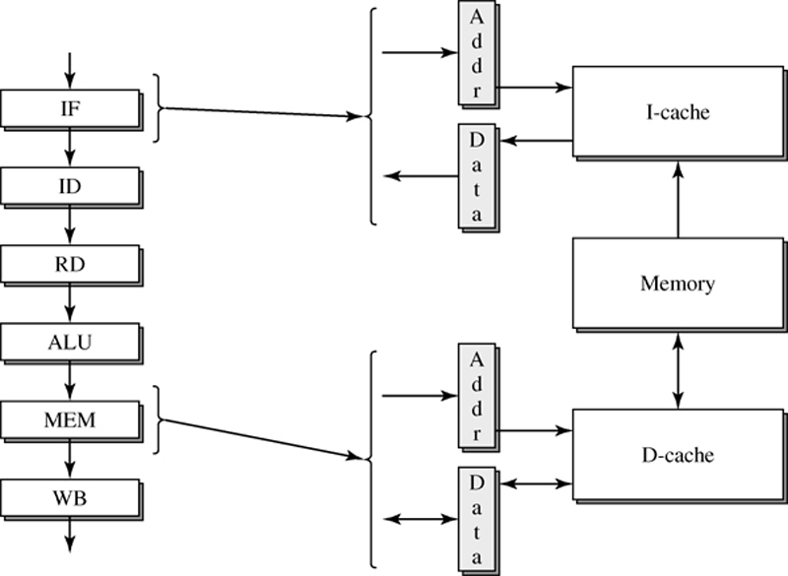
Example of a Six-Stage Pipelined Processor

Slide 47
Pipelining & Performance
The Pipeline Depth is the number of stages implemented in the processor, it is an architectural decision, also it is directly related to the technology. In the previous example K=5.
The Stall’s CPI are directly related to the code’s instructions and the density of existing dependences and branches.
Ideally the CPI is ONE.

Slide 48
Limitations of Pipelines
Scalar upper bound on throughput
  IPC <= 1 or CPI >= 1
Inefficient unified pipeline
  Long latency for each instruction
Rigid pipeline stall policy
  One stalled instruction stalls all newer instructions

Slide 49
Scalar Unpipelined Processor
Only ONE instruction can be resident at the processor at any given time. The whole processor is considered as ONE stage, k=1.
Scalar upper bound on throughput
IPC <= 1 or CPI >= 1
CPI = 1 / IPC
One Instruction
resident in Processor
The number of stages
,
K
=
1

Slide 50
Pipelined Processor
K –number of pipe stages, instructions are resident at the processor at any given time.
In our example, K=5 stages, number of parallelism (concurrent instruction in the processor) is also equal to 5.
One instruction will be accomplished each clock cycle,
CPI = IPC = 1

Slide 51
Limitations of Scalar Pipelines
Instructions, regardless of type, traverse the same set of pipeline stages.
Only one instruction can be resident in each pipeline stage at any time.
Instructions advance through the pipeline stages in a lockstep fashion.
Upper bound on pipeline throughput.

Slide 52
Deeper Pipeline, a Solution?
Performance is proportional to (1) Instruction Count, (2) Clock Rate, & (3) IPC –Instructions Per Clock.
Deeper pipeline has fewer logic gate levels in each stage, this leads to a shorter cycle time & higher clock rate.
But deeper pipeline can potentially incur higher penalties for dealing with inter-instruction dependences.

Slide 53
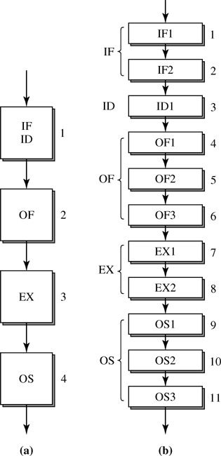
Stage Quantization
(a) four-stage instruction pipeline
(b) eleven-stage instruction pipeline

Slide 54
Bounded Pipelines Performance
Scalar pipeline can only initiate at most one instruction every cycle, hence IPC is fundamentally bounded by ONE.
To get more instruction throughput, we must initiate more than one instruction every machine cycle.
Hence, having more than one instruction resident in each pipeline stage is necessary; parallel pipeline.

Slide 55
Temporal & Spatial Machine Parallelism
A k-stage pipeline can have k instructions concurrently resident in the machine & can potentially achieve a factor of k speedup over nonpipelined machines.
Alternatively, the same speedup can be achieved by employing k copies of the nonpipelined machine to process k instructions in parallel.
K = 1
No Parallelism
Temporal Parallelism
Spatial Parallelism

Slide 56
Parallel Pipelines
Spatial parallelism requires replication of the entire processing unit hence needs more hardware than temporal parallelism.
Parallel pipelines employs both temporal & spatial machine parallelism, that would produce higher instruction processing throughput.

Slide 57
Parallel Pipelines
For parallel pipelines, the speedup is primarily determined by the width of the parallel pipeline.
A parallel pipeline with width s can concurrently process up to s instructions in each of its pipeline stages; and produce a potential speedup of s.

Slide 58
Inefficient Unification into a Single Pipeline
But in execution stages ALU & MEM there is substantial diversity.
Instructions that require long & possibly variable latencies (F.P. Multiply & Divide) are difficult to unify with simple instructions that require only a single cycle latency.

Slide 59
Diversified Pipelines
Specialized execution units customized for specific instruction types will contribute to the need for greater diversity in the execution stages.
For parallel pipelines, there is a strong motivation to implement multiple different execution units –subpipelines, in the execution portion of parallel pipeline. We call such pipelines diversified pipelines.

Slide 60
Diversified Pipelines
In a unified pipeline, though each instruction type only requires a subset of the execution stages, it must traverse all the execution stages –even if idling.
The execution latency for all instruction types is equal to the total number of execution stages; resulting in unnecessary stalling of trailing instructions.

Slide 61
Inefficient Unification into a Single Pipeline
Different instruction types require different sets of computations.
In IF, ID there is significant uniformity of different instruction types.

Slide 62
Diversified Pipelines
Instead of implementing s identical pipes in an s-wide parallel pipeline, diversified execution pipes can be implemented using multiple Functional Units.

Slide 63
Advantages of Diversified Pipelines
Efficient hardware design due to customized pipes for particular instruction type.
Each instruction type incurs only the necessary latency & make use of all the stages.
Possible distributed & independent control of each execution pipe if all inter-instruction dependences are resolved prior to dispatching.

Slide 64
Diversified Pipelines Design
The number of functional units should match the available I.L.P. of the program. The mix of F.U.s should match the dynamic mix of instruction types of the program.
Most 1st generation superscalars simply integrated a second execution pipe for processing F.P. instructions with the existing scalar pipeline.

Slide 65
Diversified Pipelines Design (2)
In 4-issue machines, 4 F.U.s are implemented for executing integer, F.P., Load/Store, & branch instructions.
Later, designs incorporated multiple integer units, some dedicated for long latency integer operations: multiply & divide, and operations for image, graphics, signal processing applications.

Slide 66
The Sequel of the i486: Pentium Microprocessor
Mmachine implementing a parallel pipeline of width s=2.
Essentially implements two i486 pipelines, a 5-stage scalar pipeline.

Slide 67
Pentium Microprocessor
Multiple instructions can be fetched & decoded by the first 2 stages of the parallel pipeline in every machine cycle.
In each cycle, potentially two instructions can be issued into the two execution pipelines.
The goal is to achieve a peak execution rate of two instructions per machine cycle.
The execute stage can perform an ALU operation or access the D-cache hence additional ports to the RF must be provided to support 2 ALU operations.

Slide 68
Rigid Pipeline Stall Policy
Backward
Propagation
of Stalling
Bypassing
Stalled
of Stalled
Instruction
Instruction
Not Allowed
Notes:
Think McDonalds: even though looking over the menu is pipelined with ordering, food prep, and delivery, the two are stalled: if the person in front of you has a special order (no ketchup or pickles) and the employee can’t find it under the heatlamp, all customers behind this customer are stalled. Another model is much better, where ordering is in-order, but food prep and order delivery occur out of order.

Slide 69
Performance Lost Due to Rigid Pipelines
Instructions advance through the pipeline stages in a lockstep fashion; in-order & synchronously.
If a dependent instruction is stalled in pipeline stage i, then all earlier stages, regardless of their dependency or NOT, are also stalled.

Slide 70
Rigid Pipeline Penalty
Only after the inter-instruction dependence is satisfied, that all i stalled instructions can again advance synchronously down the pipeline.
If an independent instruction is allowed to bypass the stalled instruction & continue down the pipeline stages, an idling cycle of the pipeline can be eliminated.

Slide 71
Out-Of-Order Execution
It is the act of allowing the bypassing of a stalled leading instruction by trailing instructions. Parallel pipelines that support out-of-order execution are called dynamic pipelines.

Slide 72
Characteristics of Superscalar Machines
Simultaneously advance multiple instructions through the pipeline stages.
Multiple functional units => higher instruction execution throughput.
Able to execute instructions in an order different from that specified by the original program.
Out of program order execution allows more parallel processing of instructions.

Slide 73
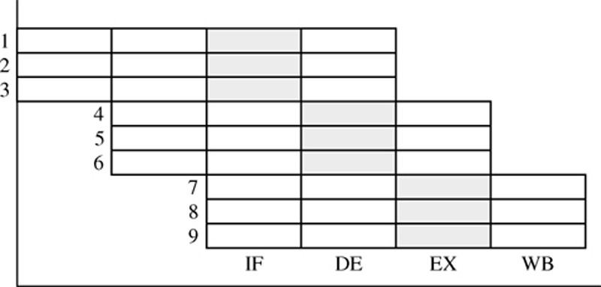
Superscalar machine of Degree n=3
The superscalar degree is determined by the issue parallelism n, the maximum number of instructions that can be issued in every machine cycle.
Parallelism = K x n.
For this figure,
//’ism = K x n = 4 x 3 =12

Slide 74
From Scalar to Superscalar Pipelines
Superscalar pipelines are parallel pipelines: able to initiate the processing of multiple instructions in every machine cycle.
Superscalar are diversified; they employ multiple & heterogeneous functional units in their execution stages.
They are implemented as dynamic pipelines in order to achieve the best possible performance without requiring reordering of instructions by the compiler.

Slide 75
Dynamic Pipelines
Superscalar pipelines differ from (rigid) scalar pipelines in one key aspect; the use of complex multi-entry buffers.
In order to minimize unnecessary staling of instructions in a parallel pipeline, trailing instructions must be allowed to bypass a stalled leading instruction.
Such bypassing can change the order of execution of instructions from the original sequential order of the static code.

Slide 76
Dynamic Pipelines (2)
With out-of-order execution of instructions, they are executed as soon as their operands are available; this would approach the data-flow limit of execution.

Slide 77
Dynamic Pipelines (3)
A dynamic pipeline achieves out-of-order execution via the use of complex multi-entry buffers that allow instructions to enter & leave the buffers in different orders.

Slide 78
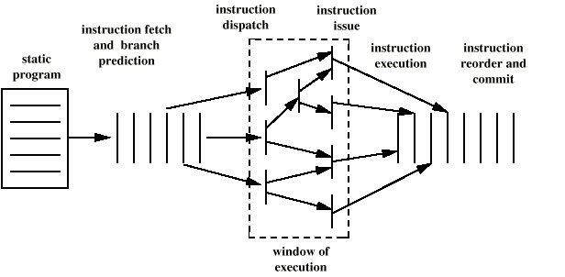
Superscalar Execution

Slide 79
Superscalar Pipeline Stages
In
Program
Order
Out
of
Order
In
Program
Order

Slide 80
Limitations of Scalar Pipelines
Scalar upper bound on throughput
  IPC <= 1 or CPI >= 1
  Solution: wide (superscalar) pipeline
Inefficient unified pipeline
  Long latency for each instruction
  Solution: diversified, specialized pipelines
Rigid pipeline stall policy
  One stalled instruction stalls all newer instructions
  Solution: Out-of-order execution, distributed execution pipelines

Slide 81
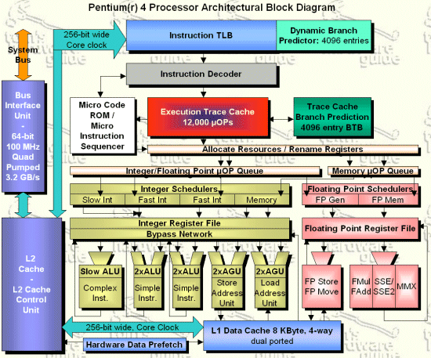

Slide 82
Extra Slides

Slide 83
Pentium 4
80486 - CISC
Pentium – some superscalar components
  Two separate integer execution units
Pentium Pro – Full blown superscalar
Subsequent models refine & enhance superscalar design

Slide 84
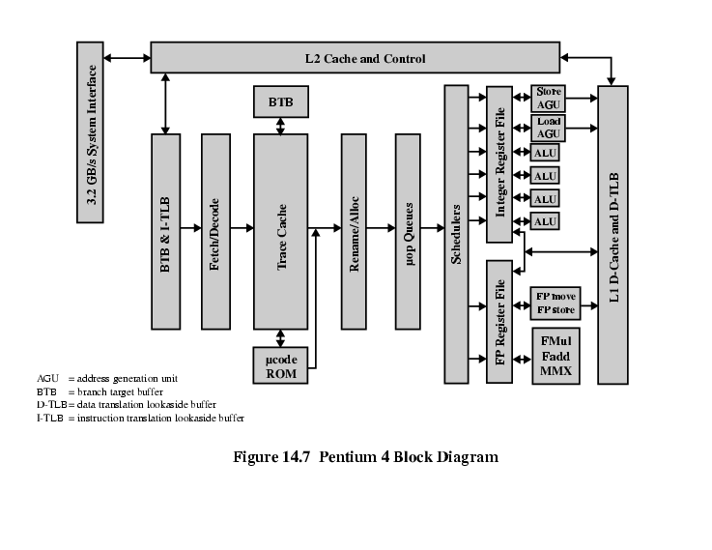
Pentium 4 Block Diagram

Slide 85
Pentium 4 Operation
Fetch instructions form memory in order of static program
Translate instruction into one or more fixed length RISC instructions (micro-operations)
Execute micro-ops on superscalar pipeline
  micro-ops may be executed out of order
Commit results of micro-ops to register set in original program flow order
Outer CISC shell with inner RISC core
Inner RISC core pipeline at least 20 stages
  Some micro-ops require multiple execution stages
    Longer pipeline
  c.f. five stage pipeline on x86 up to Pentium

Slide 86
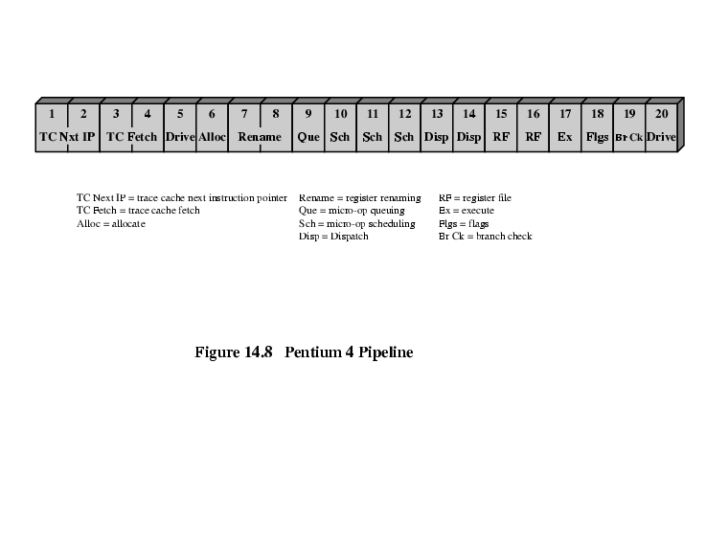
Pentium 4 Pipeline

Slide 87
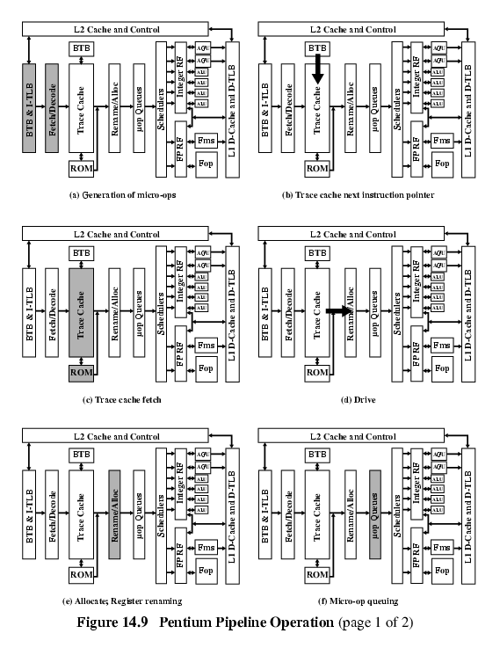
Pentium 4 Pipeline Operation (1)

Slide 88
Pentium 4 Pipeline Operation (2)

Slide 89
Pentium 4 Pipeline Operation (3)

Slide 90
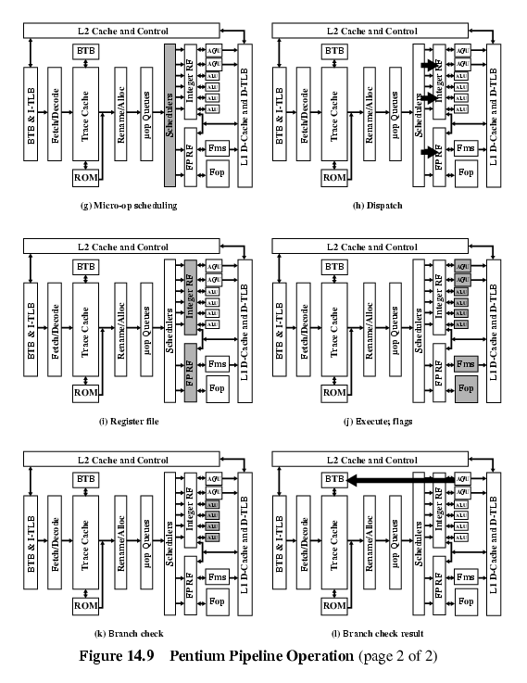
Pentium 4 Pipeline Operation (4)

Slide 91
Pentium 4 Pipeline Operation (5)

Slide 92
Pentium 4 Pipeline Operation (6)

Slide 93
Introduction to PowerPC 620
The first 64-bit superscalar processor to employ:
  Aggressive branch prediction,
  Real out-of-order execution,
  Six pipelined execution units,
  Dynamic renaming for all register files,
  Distributed multientry reservation stations,
  A completion buffer to ensure program correctness.
Most of these features had not been previously implemented in a single-chip microprocessor.

