Slide 1
Distributed Systems
CS 15-440
Introduction
Lecture 1, August 20, 2023
Mohammad Hammoud

Slide 2


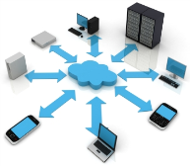
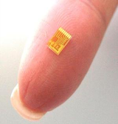
On the Verge of A Disruptive Century : Breakthroughs
Deepest Infrared Image of Universe
Delivered by NASA’s JWST in 2022
Astronomy
Ubiquitous Computing
Smaller, Faster, Cheaper Sensors
Gene Sequencing and Biotechnology

Slide 3
A Common Theme is Data
~70% of the world’s data was generated only over the past two years

Slide 4
We Live in a World of Data…
A few examples (all per day):
  333.22 billion emails sent
  129.89 billion crypto purchased
  8.5 billion Google searches
  1.44 billion hours streamed
  637.92 million USD spent on Amazon
  150.62 million hours spent in Zoom meetings
  110.02 million USD spent on DoorDash
  …

Slide 5
What Do We Do With Data?
Store
Access
Encrypt
…. and more!
Process
Share

Slide 6
How to Store and Process Data at Scale?
A system can be scaled:
  Either vertically (or up)
    Can be achieved by hardware upgrades (e.g., faster CPU, more memory, and/or larger disk)
  And/Or horizontally (or out)
    Can be achieved by adding more machines

Slide 7
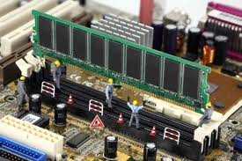
Vertical Scaling
Caveat: Individual computers can still suffer from limited resources with respect to the scale of today’s problems
  Caches and Memory:
L1
Cache
L2 Cache
L3 Cache
Main Memory
16-32 KB/Core, 4-5 cycles
128-256 KB/Core, 12-15 cycles
512KB- 2 MB/Core, 30-50 cycles
8GB- 128GB, 300+ cycles

Slide 8
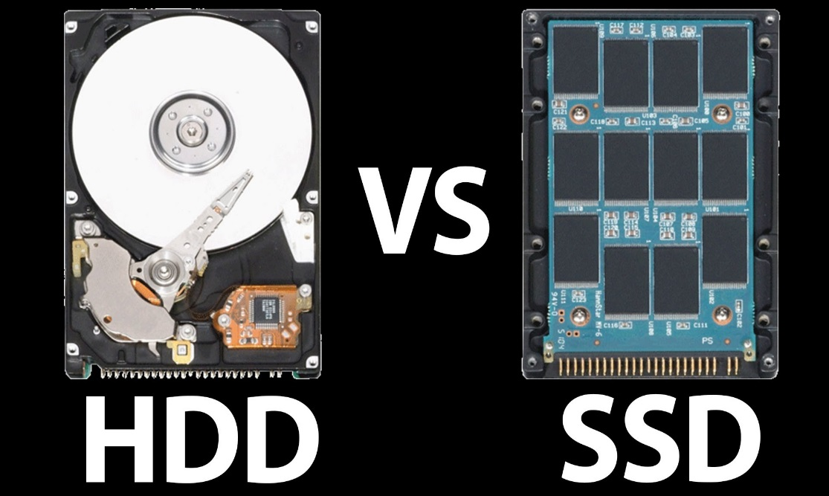
Vertical Scaling
Caveat: Individual computers can still suffer from limited resources with respect to the scale of today’s problems
  Disks-- some advancements, but still:
    Limited capacity
    Limited number of channels
    Limited bandwidth

Slide 9
Vertical Scaling
Caveat: Individual computers can still suffer from limited resources with respect to the scale of today’s problems
  Processors:
    Moore’s law still holds
    Chip Multiprocessors (CMPs) are ubiquitous
P
P
P
P
P
L1
L1
L1
L1
L1
Interconnect
L2
L2 Cache
A single Processor Chip
A CMP
Notes:
- Moore’s law states that the number of transistors that can be placed in a processor will double approximately every two years, for half the cost.

Slide 10
Vertical Scaling
Caveat: Individual computers can still suffer from limited resources with respect to the scale of today’s problems
  Processors:
    But up until a few years ago, CPU speed grew at the rate of 55% annually, while the memory speed grew at the rate of only 7%
P
Processor-Memory speed gap
M

Slide 11
Vertical Scaling
Caveat: Individual computers can still suffer from limited resources with respect to the scale of today’s problems
  Processors:
    But up until a few years ago, CPU speed grew at the rate of 55% annually, while the memory speed grew at the rate of only 7%
    Even if 100s or 1000s of cores are placed on a CMP, it is a challenge to deliver input data to these cores fast enough for processing

Slide 12
Vertical Scaling
10000 seconds (or 3 hours) to load data
P
P
P
P
L1
L1
L1
L1
Interconnect
A Data Set
of 4 TBs
L2 Cache
Memory
4 100MB/S IO Channels

Slide 13
How to Store and Process Data at Scale?
A system can be scaled:
  Either vertically (or up)
    Can be achieved by hardware upgrades (e.g., faster CPU, more memory, and/or larger disk)
  And/Or horizontally (or out)
    Can be achieved by adding more machines

Slide 14
Horizontal Scaling
Only 3 minutes to load data
P
100
Machines
P
Splits
L1
L1
L2
L2
Memory
Memory
A Data Set (data)
of 4 TBs

Slide 15
Requirements
But, this necessitates:
  A way to express the problem in terms of parallel processes and execute them on different machines (Programming and Concurrency Models)
  A way to organize processes (Architectures)
  A way for distributed processes to exchange information (Communication Paradigms)
  A way to locate and share resources (Naming Protocols)

Slide 16
Requirements
But, this necessitates:
  A way for distributed processes to cooperate, synchronize with one another, and agree on shared values (Synchronization)
  A way to reduce latency, enhance reliability, and improve performance (Caching, Replication, and Consistency)
  A way to enhance load scalability, reduce diversity across heterogeneous systems, and provide a high degree of portability and flexibility (Virtualization)
  A way to recover from partial failures (Fault Tolerance)

Slide 17
So, What is a Distributed System?
A distributed system is:
A collection of independent computers that appear to its users as a single coherent system
One in which components located at networked computers communicate and coordinate their actions only by passing messages

Slide 18
Features
Distributed Systems imply four main features:
1
Geographical Separation
2
No Common Physical Clock
No Common Physical Memory
3
4
Autonomy and Heterogeneity

Slide 19
Parallel vs. Distributed Systems
Distributed systems contrast with parallel systems, which entail:
1
Strong Coupling
2
A Common Physical Clock
A Shared Physical Memory
3
4
Homogeneity

Slide 20
Some Administrivia!

Slide 21
Introduction to Distributed Systems
Considered: a reasonably critical and
comprehensive perspective.
Thoughtful: Fluent, flexible and efficient
perspective.
Masterful: a powerful and illuminating
perspective.
.9. Cutting-edge technologies (6 Lectures)
.8. Fault Tolerance (1 Lecture)
.7. Replication (2 Lectures)
.6. Caching (2 Lectures)
.5. Synchronization (3 Lectures)
.4. Naming (2 Lectures)
.3. Remote Procedure Calls (3 Lectures)
.2. Architectures (1 Lecture)
.1. Networks (2 Lectures)
.0. Introduction (1 Lecture)

Slide 22
Course Objectives
The course aims at providing an in-depth understanding and hands-on experience on the
Architectures, communication
paradigms, naming,
and synchronization
Cutting-edge
new
technologies
Cloud Computing,
Edge Computing,
and Blockchain
Classical and modern distributed system programming models
Principles on which distributed systems are optimized
Principles on which distributed systems are based
MPI, MapReduce, Spark,
and Snowflake
Replication and fault tolerance

Slide 23
Assessment Methods
How do we measure learning?
To pass the course, you need to pass the hands-on (i.e., projects) and the theory components
Type | Number | Weight
Project | 4 | 40%
Exam | 2 | 30% (Midterm: 10% & Final: 20%)
Problem Set | 5 or 6 | 12%
Quiz | 2 | 8%
Attendance & Participation | 40 | 10%

Slide 24
Rules on the Projects
For all the projects except the final one, the following rules apply:
  If you submit one day late, 25% will be deducted from your project score
  If you are two days late, 50% will be deducted
  The project will not be graded (and you will receive a zero score) if you submit more than two days late
  You have a 3-grace-day quota

Slide 25
Next Lecture…
Networks- Part I
Questions?

