Slide 1
CS15-346 Perspectives in Computer Architecture
Chip Multiprocessors, Introduction and Challenges
Lecture 8
February 6, 2013
Mohammad Hammoud

Slide 2
Objectives
Discussion on Chip Multiprocessors
Advanced Topics on CMP Cache Organizations
Unique CMP Challenges: Performance Volatility, Scalability Problems, and CMP Cache Organizations
Moving to Chip Multiprocessors (CMPs)
Traditional Parallel Computers
Motivation for Parallel Computers

Slide 3
Objectives
Discussion on Chip Multiprocessors
Advanced Topics on CMP Cache Organizations
Unique CMP Challenges: Performance Volatility, Scalability Problems, and CMP Cache Organizations
Moving to Chip Multiprocessors (CMPs)
Traditional Parallel Computers
Motivation for Parallel Computers

Slide 4
Why Parallel Computers?
Computer architects have long sought to create parallel computers by combining a large number of processing elements into a single system
Parallel computers allow a large computation to be carried out in orders of magnitude shorter execution time
Scientists and engineers have relied on parallel computers to solve important and complex scientific problems
Parallel computers have also found a broader audience outside science, such as serving search engines, Web servers and databases
There have been needs for parallel computers, and there will be even more needs for them in the future
Notes:
Parallel computers that serve search engines are referred to as clusters

Slide 5
Parallel Computers Today
Before 2001, parallel computers were mainly used in the server and supercomputer markets
Since 2001, parallel computers have evolved as an architecture in which multiple processor cores are implemented on a single chip
Such an architecture is popularly known as multicore or chip multiprocessors (CMPs)
With the adoption of CMPs, virtually all new laptops, desktops, and servers are now parallel computers
Today, CMP is the architecture of choice

Slide 6
Objectives
Discussion on Chip Multiprocessors
Advanced Topics on CMP Cache Organizations
Unique CMP Challenges: Performance Volatility, Scalability Problems, and CMP Cache Organizations
Moving to Chip Multiprocessors (CMPs)
Traditional Parallel Computers
Motivation for Parallel Computers

Slide 7
Traditional Parallel Computer Architectures
We can categorize the architecture of parallel computers in terms of two aspects:
Whether the memory is physically centralized or distributed
Whether the address space is shared or private
Memory |  | Address Space
 |  | Shared | Private
 | Centralized | SMP (Symmetric Multiprocessor)
 | Distributed
Memory |  | Address Space
 |  | Shared | Private
 | Centralized | SMP (Symmetric Multiprocessor) | N/A
 | Distributed
Memory |  | Address Space
 |  | Shared | Private
 | Centralized
 | Distributed
Memory |  | Address Space
 |  | Shared | Private
 | Centralized | SMP (Symmetric Multiprocessor) | N/A
 | Distributed | NUMA (Non-Uniform Memory Access)
Memory |  | Address Space
 |  | Shared | Private
 | Centralized | SMP (Symmetric Multiprocessor) | N/A
 | Distributed | NUMA (Non-Uniform Memory Access) | MPP (Massively Parallel Processors)

Slide 8
Symmetric Multiprocessor
Symmetric Multiprocessor (SMP) architecture uses shared system resources that can be accessed equally from all processors
Classically, a single OS controls the SMP machine
Processor
Processor
Processor
Processor
Cache
Cache
Cache
Cache
Bus or Crossbar Switch
Memory
I/O
Notes:
The SMP OS schedules processes and threads on processors so that the load is balanced

Slide 9
Massively Parallel Processors
Massively Parallel Processors (MPP) architecture consists of nodes with each having its own processor, memory and I/O subsystem
An independent OS runs at each node
Interconnection Network
Processor
Processor
Processor
Processor
Cache
Cache
Cache
Cache
Bus
Bus
Bus
Bus
Memory
I/O
Memory
I/O
Memory
I/O
Memory
I/O

Slide 10
Non-Uniform Memory Access
Non-Uniform Memory Access (NUMA) architecture machines are built on a similar hardware model as MPP
NUMA typically provides a shared address space to applications using a hardware/software directory-based coherence protocol
The memory latency varies according to whether you access memory directly (local) or through the interconnect (remote)
Thus the name non-uniform memory access
As in an SMP machine, usually a single OS controls the whole system

Slide 11
Objectives
Discussion on Chip Multiprocessors
Advanced Topics on CMP Cache Organizations
Unique CMP Challenges: Performance Volatility, Scalability Problems, and CMP Cache Organizations
Moving to Chip Multiprocessors (CMPs)
Traditional Parallel Computers
Motivation for Parallel Computers

Slide 12
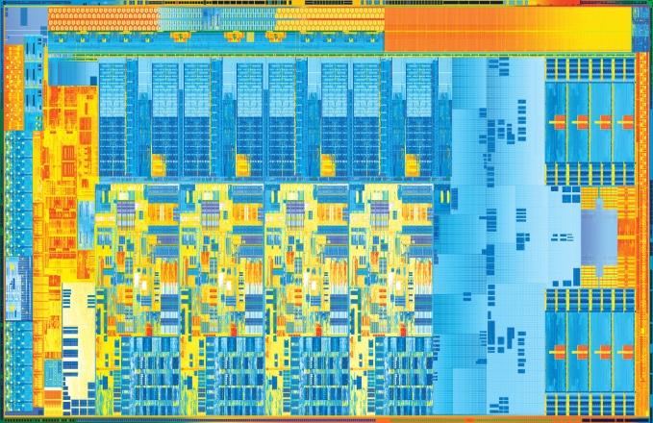
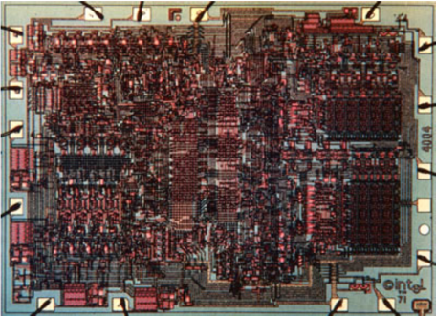
Evolution of Computers
For decades, transistor integration has faithfully followed Moore’s law
The number of transistors that can be manufactured inexpensively in a single IC doubles every two years
. . .
Intel 4004 (1971):
2300 transistors
Ivy Bridge(2012):
1.4 Billion transistors
The number of transistors have increased by a factor of 608695!
Notes:
A more recent version states that the doubling is every 18 months rather than every two years, but the original prediction was every 2 years

Slide 13
From Scalar to Superscalar
The increasing miniaturization of transistors has resulted in various processor architecture changes
Fitting more and more components in a single processor (e.g., integrating FPU in Intel 486 in 1989)
Adding more features to a single processor
Parallelism at the instruction level and out-of-order execution (Intel Pentium Pro in 1995)
L1 & L2 caches (Intel Pentium III in 1999)
Simultaneous multithreading (SMT) or parallelism at the thread level (Intel Pentium III)

Slide 14
Moving to CMPs
Instruction Level Parallelism (ILP) started to become harder
Deepening the processor pipeline
Boosted the clock frequency of the processor
But did not change the length of critical dependences between instructions
Introduced quadratic increase in complexity
Branch prediction exceeded 95% accuracy
Caches started showing diminishing returns
Power consumption increased
This required a fan, a larger heat sink etc.
Nevertheless, Moore’s law continued on, leaving a big question:
What is the most power-performance efficient way to use the extra transistors available?
Answer: Chip Multiprocessors (CMPs)!
Notes:
- Caches started showing diminishing returns (i.e., doubling the cache space reduces its miss rate by less than a half)

Slide 15
What are CMPs?
In contrast to traditional multiprocessor architectures, CMPs have multiple cores implemented on a single die
CMPs provide an attractive approach as long as performance can scale linearly with the increase in the number of cores
This is upon the ability of software to utilize the number of cores effectively
Generally, data parallel applications have high thread level parallelism suitable for execution on CMPs
Interconnect
P
P
P
P
P
P
L1
L1
L1
L1
L1
L1
Network-on-Chip (NoC)
L2
L2
L2 Cache
Bus
Bus
MPP or NUMA System
A Chip Multiprocessor (CMP) System
Notes:
- Workloads for server platforms (e.g., Web server) exhibit a large number of threads that can keep a large number of cores busy
- In client machines (e.g., desktops and laptops), there is dichotomy in the application space
- Compilers and word processors do not exhibit high level thread parallelism
- Multimedia application, applied intelligence, and data mining exhibit TLP

Slide 16
Objectives
Discussion on Chip Multiprocessors
Advanced Topics on CMP Cache Organizations
Unique CMP Challenges: Performance Volatility, Scalability Problems, and CMP Cache Organizations
Moving to Chip Multiprocessors (CMPs)
Traditional Parallel Computers
Motivation for Parallel Computers

Slide 17
Unique Challenges in CMPs
CMPs pose unique challenges as compared to multiprocessor architectures
Performance Volatility
Scalability Problems
Cache Organizations

Slide 18
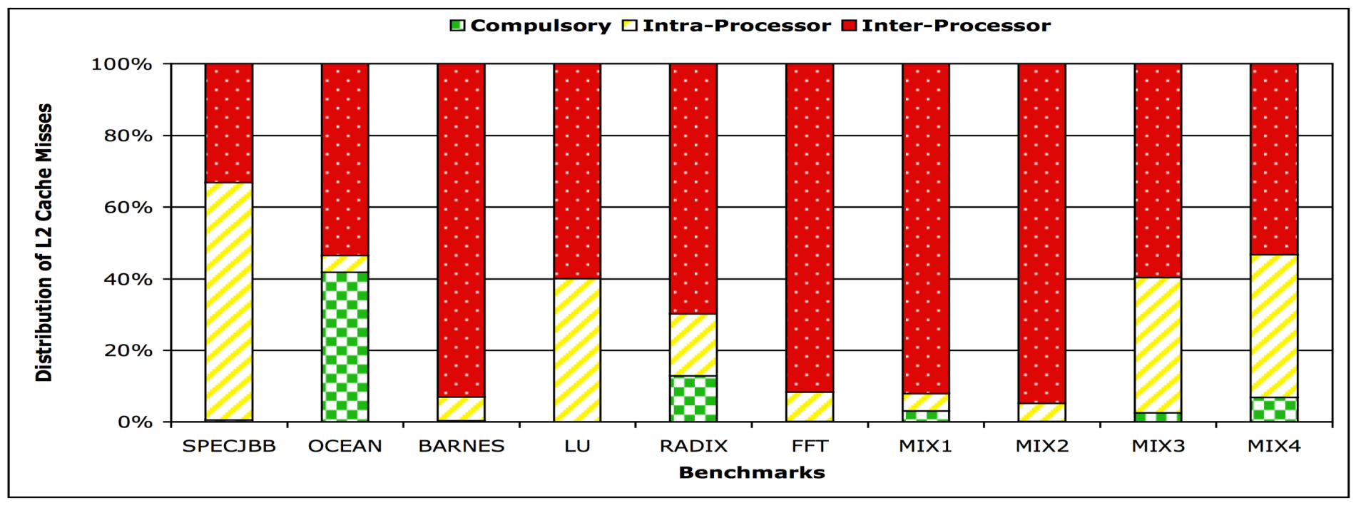
Performance Volatility
Performances of programs that compete for CMP resources vary a lot
This phenomenon is referred to as performance volatility
For instance, sharing CMP cache resources among co-scheduled threads/processes
Can reduce cache capacity pressure
But, programs might evict one another’s cache contents
How should resource contention be managed in CMPs?
On average, 6.8% of misses are compulsory, 23% are intra-processor, and 70% are inter-processor!

Slide 19
Unique Challenges in CMPs
CMPs pose unique challenges as compared to multiprocessor architectures
Performance Volatility
Scalability Problems
Cache Organizations

Slide 20
Off-Chip Bandwidth
Some on-chip resources, such as the off-chip pin bandwidth, are unavoidably shared among CMP cores
This incurs a scalability problem whereby the more cores we add on a die, the lower off-chip bandwidth becomes available for each core
This phenomenon is referred to as the bandwidth wall problem
While off-chip bandwidth will grow over time, its projected rate of growth trails the growth rate of transistors that can be packed on a die
Roughly 50-70% versus 10-15% per year
Hence, among the unique challenges of CMPs are:
To what extent does the bandwidth wall problem restrict CMP scalability?
What techniques can mitigate the bandwidth wall problem?
Notes:
This off-chip bandwidth sharing is a new problem in CMPs
A main question: how to scale despite the declining of off-chip bandwidth per core?

Slide 21
Main Memory
There are main memory concerns as well upon scaling CMP cores
Specifically, scaling up the number of cores per a chip requires at least a proportional increase in the size of the main memory
This is to keep the size of the main memory per core constant
However, the main memory size may need to grow faster than Moore’s law
This is due to the continuing increase in software complexity (i.e., larger working sets would require larger main memories)
If the main memory capacity grows at Moore’s law while the demand for that capacity grows faster than Moore’s law, the cost of the main memory will increase in the future
This makes memory design an increasingly essential issue

Slide 22
Unique Challenges in CMPs
CMPs pose unique challenges as compared to multiprocessor architectures
Performance Volatility
Scalability Problems
Cache Organizations

Slide 23
How to Organize CMP Caches?
In CMPs, it is feasible to have multiple cores sharing caches
A unique challenge pertains to how should CMP caches be organized
There are various ways to organize caches in a CMP
Private CMP
Shared CMP
P
P
P
P
P
P
P
P
P
P
P
P
NoC
L1$
L1$
L1$
L1$
L1$
L1$
L1$
L1$
L2$
L2$
L2$
L2$
NoC
L1$
NoC
L2$
L2$
L2$
L2$
L2$
Average L2 access latency is high
L2 cache miss rate can be low
The NoC time is directly added to the L1 cache access time
L2 access latency is low
L2 cache miss rate can be high
Notes:
Adding a few cycles to each L1 cache access can significantly degrade performance
In private caches, a core maps and locates every cache block to and from its local L2 bank
In a shared cache, a core maps and locates cache blocks to and from target banks

Slide 24
Network-on-Chip as a Crossbar
An NoC can be implemented as a crossbar whereby multiple buses can be used
We can employ
One address bus and one data bus per core to connect to all banks
One data bus for each L2 bank to connect to all L1 caches
$Number of Buses=Number of Cores+Number of L2 Banks$
The length of each bus scales with the number of cores/banks
Overall complexity scales quadratically with the number of cores/banks
P
P
P
P
L1-I
L1-D
L1-I
L1-D
L1-I
L1-D
L1-I
L1-D
L2$
L2$
L2$
L2$
Notes:
A unique characteristic of CMPs is that cores, caches, and NoC compete for the same die area

Slide 25
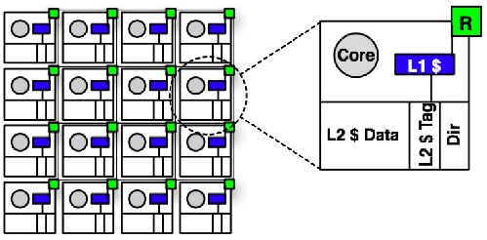
Network-on-Chip as a 2D Mesh
A more scalable and modular way to implement the NoC is to use low or high dimensional interconnects
A typical configuration that adopts this strategy is what is called tiled CMP
Tiled CMPs have been advocated as a scalable design by Tilera’s Tile64 and Intel’s Teraflops RC
Notes:
A unique characteristic of CMPs is that cores, caches, and NoC compete for the same die area

Slide 26
Objectives
Discussion on Chip Multiprocessors
Advanced Topics on CMP Cache Organizations
Unique CMP Challenges: Performance Volatility, Scalability Problems, and CMP Cache Organizations
Moving to Chip Multiprocessors (CMPs)
Traditional Parallel Computers
Motivation for Parallel Computers

Slide 27
CMP Cache Organization
We will cover two more advanced topics in CMP cache organization
Mapping Functions in CMPs
Static and Dynamic Cache Organizations

Slide 28
Mapping Functions in CMPs
For a private CMP, the mapping function is one-dimensional
The function that is used in uniprocessor systems can be used at each private L1 and L2 caches to place and locate blocks
For a shared CMP, the mapping function is two-dimensional
First, we require a function to locate a target tile at which to place a block
After locating a target tile, we can use the same placement/location function as in uniprocessor systems
A function for locating target tiles should exhibit the following two properties
It should be easy and simple
It should avoid uneven distribution of blocks across tiles

Slide 29
A Block Interleaving Function
A CMP mapping function can use bits that are a subset of the index bits of the physical block address
Such a function is typically referred to as Block Interleaving
With block interleaving, only a certain group of sets will be indexed (other sets will not be used)
Suppose a tile index of “1000” in a 16-tile CMP
Tile Index
Tag | Index | offset
1000
T0
T1
T2
T3
Tag | Index | offset
Only sets with “1000”
least significant bits at
tile 8 will be used!
T4
T0
T0
T0
T8
T0
T0
T0
T0
T0
T0
T0
Notes:
- This implies non-uniform use of sets. In essence, it produces a pathological mapping.

Slide 30
A Page Interleaving Function
A CMP mapping function can use bits that are beyond the page offset bits
Such a function is typically referred to as Page Interleaving
Page Interleaving may produce a pathological mapping as well
This depends, however, on the number of sets on a cache tile versus the size of a page
Suppose a tile index of “1000”, if we had:
An L2 bank with 512KB size, 8-way associativity, and 64B block size
A 4KB page → Page offset = $\log_{2}{4096=12 bits}$
$$Block Offset= \log_{2}{64=6 bits}$$
1000
Tag | Index | offset
An overlap of 4 bits with the index
$$Index=\log_{2}{\frac{512}{8∗64}=10 bits}$$
In this case, only sets with “1000” most significant bits at tile 8 will be used!
Notes:
- This implies non-uniform use of sets

Slide 31
No-Bit Overlap Function
A CMP mapping function can use bits that are beyond the index bits of the physical block address
This function is called No-Bit Overlap function as it avoids overlapping with the index bits
The problem with the No-Bit Overlap function is that it lies at the higher order bits
The higher order bits do not vary as much as the lower order bits
This implies a non-uniform usage of tiles as it becomes possible for programs to use only few tiles
What about that we spread (or randomize) the tile index bits?
Tile Index
Tag | Index | offset

Slide 32
No-Bit Overlap with Randomization Function
A CMP mapping function
Can use bits that are beyond the index bits of the physical block address
Should randomize them to avoid non-uniform usage of tiles
Such a function is referred to as No-Bit Overlap with Randomization function
A way to randomize the tile index bits is by XOR-ing the high order bits with some low order bits
Tag | Index | offset
Tile Index
This will spread tile index values!

Slide 33
CMP Cache Organization
We will cover two more advanced topics in CMP cache organization
Mapping Functions in CMPs
Static and Dynamic Cache Organizations

Slide 34
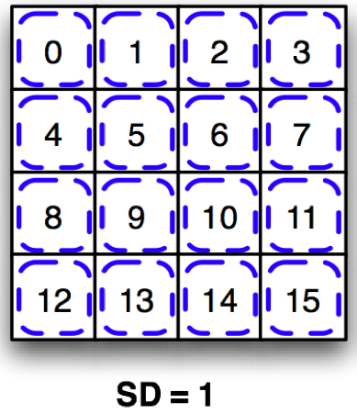
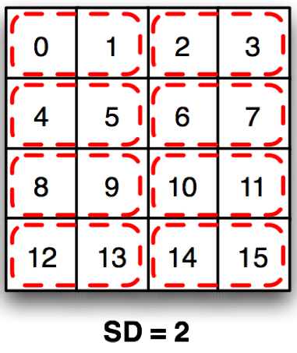
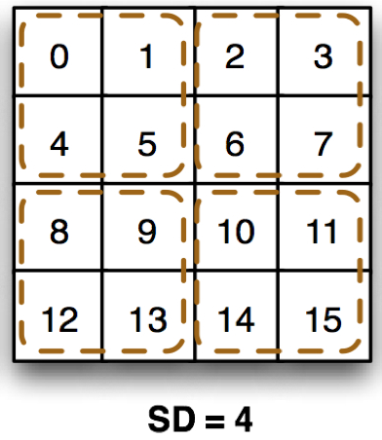
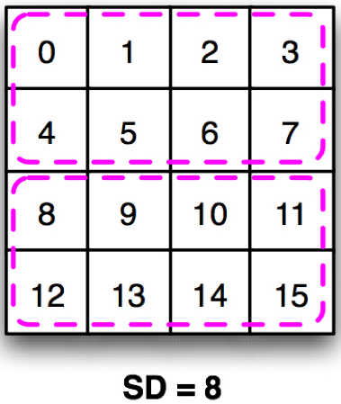
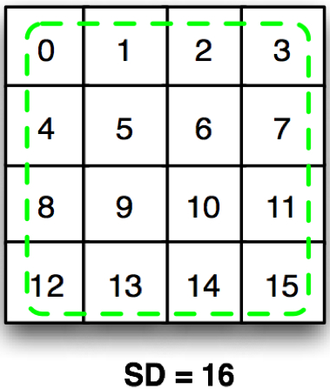
Static CMP Cache Organizations
Private and Shared CMP caches are the conventional organizations
There are other possible ways to organize CMP caches
Specifically, a number of cores can be set to share a given pool of cache banks, somewhere between the shared and the private designs [J. Huh et. al., 2005]
This number is typically denoted as the Sharing Degree (SD)
Static Organization 1 (SO-1)
Static Organization 2 (SO-2)
Static Organization 4 (SO-4)
Static Organization 8 (SO-8)
Static Organization 16 (SO-16)
1-1 assignment
2-2 assignment
4-4 assignment
8-8 assignment
16-16 assignment
[Private Organization]
[Shared Organization]
Notes:
Parallel computers that serve search engines are referred to as clusters

Slide 35
Main Deficiency of Static Designs
The SO-n organizations are subject to a principal deficiency:
In reality, computer programs exhibit different cache demands
A single program may demonstrate different phases corresponding to distinct code regions invoked during its execution
They all entail static partitioning of the available cache capacity and do not tolerate the variability among working sets and phases of a working set
Notes:
- Program phases can be characterized by different L2 cache misses and durations

Slide 36
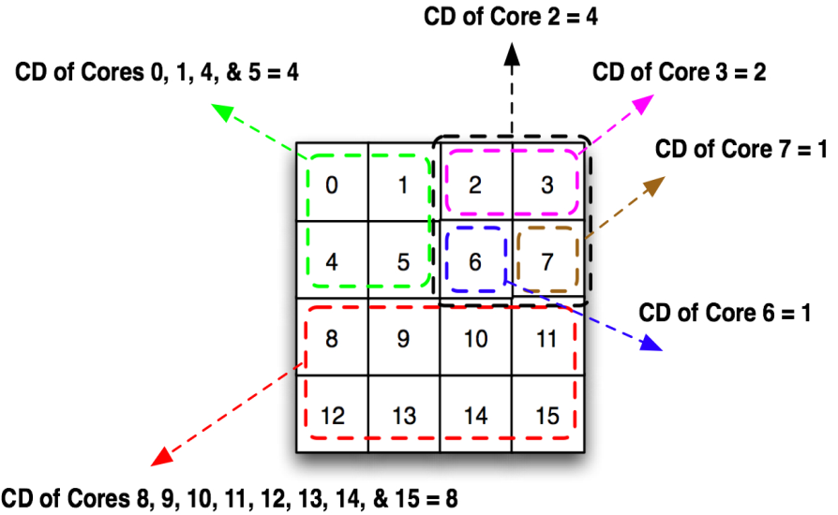
A Dynamic CMP Cache Organization
The behaviors of programs can be dynamically monitored and the cache organization can be adapted based on the observed demands [Hammoud et al. 2009]
This implies offering a fine-grained bank-to-core assignments, a technique we refer to as cache clustering
This will require developing a new mapping function! (see the paper)
(CD = Cluster Dimension)

Slide 37
CMPs in a Nutshell
The architecture of choice
Good for applications that exhibit high TLP
However, it exposes some unique challenges that need to be addressed effectively
Future of CMPs?

Slide 38
This Week’s Challenge
For the following two scenarios, suggest a suitable architecture for your desktop (Superscalar or CMP) and argue why:
Scenario 1: Real-time compression
Scenario 2: Modern web browser viewing multiple multimedia streams simultaneously

Slide 39
Thank You!
Next Class:
A Walk-Through Computer Architectures from Digestible to the Largest and Fastest- Part I
(by Gordon Bell)

Slide 40
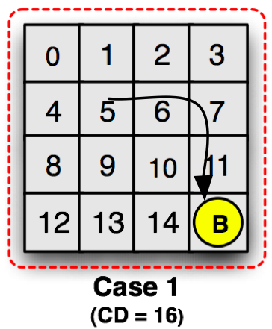
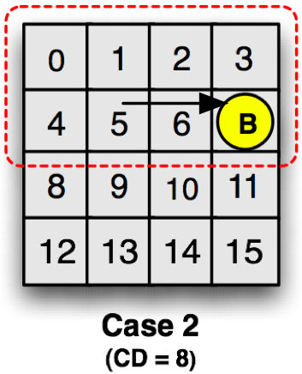
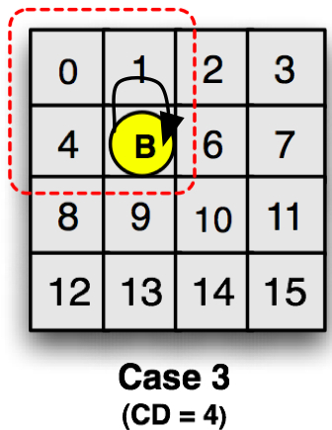
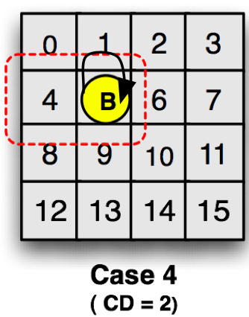
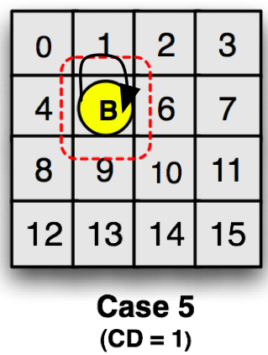
Dynamic Mapping Function
We developed a mapping function that can dynamically determine the Target Tile (TT) of every cache block B
Assume core 5 (ID = 0101) requests cache block B with tile index = 1111
TT= (1111&1111) +
(0101&0000) = 1111
TT= (1111&0111) +
(0101&1000) = 0111
TT= (1111&0101) +
(0101&1010) = 0101
TT= (1111&0001) +
(0101&1110) = 0101
TT= (1111&0000) +
(0101&1111) = 0101

Slide 41
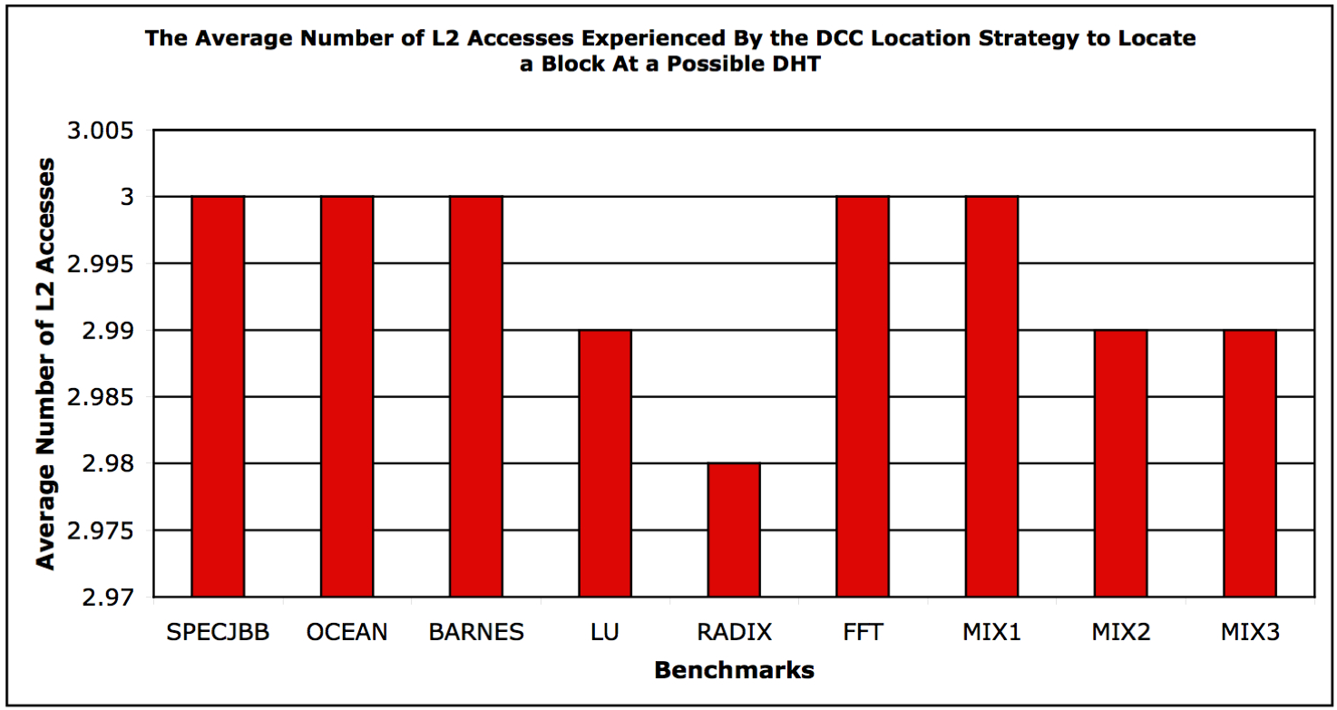
How to Locate the Blocks?
The question becomes, how to locate blocks?
Send simultaneous requests to only the tiles that are potential target tiles (TTs)
The potential TTs of a cache block can be determined by varying MB and MB-bar of the dynamic mapping function for different cluster dimensions
Upper bound = $\log_{2}{(number of tiles)}+1$
Lower bound = 1
Average = $1+\frac{1}{2}\log_{2}{n}$ (i.e., for 16 tiles, 3 messages per request)

